Slide 1
Let’s Chat:
Engaging Your Community Through Community Dialogues
Ashley M. Spencer
Youth Services Librarian
Thelma Parker Memorial Public and School Library
Hawai‘i Library Association Conference 2019
Notes:
-2016 selected as one of 75 libraries participate in NAML initiative -Dialogue in May 2018 focusing on STEM and students –focus of session = overview of CD and how they can help libraries understand community changes and meet needs + HTP dialogue.

Slide 2
What is a Community Dialogue
Loosely facilitated discussion
  You create questions to guide conversation
Opportunity for library and community to meet
  Invite specific people
Discuss a single topic
  Brainstorm session
  Changes for your library and community
Notes:
-variety of ways to conduct dialogues. –at core: discussions library staff and selected community members/leaders. –discussion focused single topic, guided by questions, gain data about library usage. –brainstorm session. (HTP – brainstorm session, suggestions not to-do list, gain understanding)

Slide 3
So You Want to Host a Dialogue
  How is the library used?
  How would you like it to be used?
  Who uses/does not use the library?
  What about your library do you want to gather information and feedback on?
  How do you want to change and improve your library services or collections?
Notes:
Considerations in planning of dialogue -These Qs will help decide topic. -who to invite. –question creating. –solid dialogue focus creates informative conversation; generates relevant data –weak focus, shaky questions = erratic responses and data
(HTP: STEM focus: few middle/ high school researchers or teachers. How to get them in?)

Slide 4
Outcomes - Data, oh yeah!
Obtain meaningful feedback and data
  How the library is used
  How and why the library is not used
Expand our understanding of patron viewpoint
  Collections, services, programs
How the library can better serve underserved and underrepresented audiences
Connect with local organizations and potential future partners
Notes:
Thru CD gain greater understanding library usage w/specific groups, why/why not, library role, gaps. -better serve underserved / underrepresented audiences: ask their needs. -success through collaboration. (HTP: library = books: educators not aware of online services, research via internet, talk about this a bit later.)

Slide 5
You’ve Got Questions
Guide Dialogue conversation
Ask questions that gauge community needs and interests
Are there gaps in meeting these needs and interests?
Ask: Who is not at the dialogue but may be able to contribute to the conversation? How do we bring them into the conversation?
Notes:
-question lists online, may not fit library topic. -gauge community needs/ interests. -identify existing gaps in meeting needs. -community leaders not present
(HTP: STEM focused questions: extracurricular options for students (more than I thought), challenges in students relating to STEM (negative mindset all around), how can HTP help close gaps (invite experts, program alerts), reaching underserved/represented audiences (outreach community events).

Slide 6
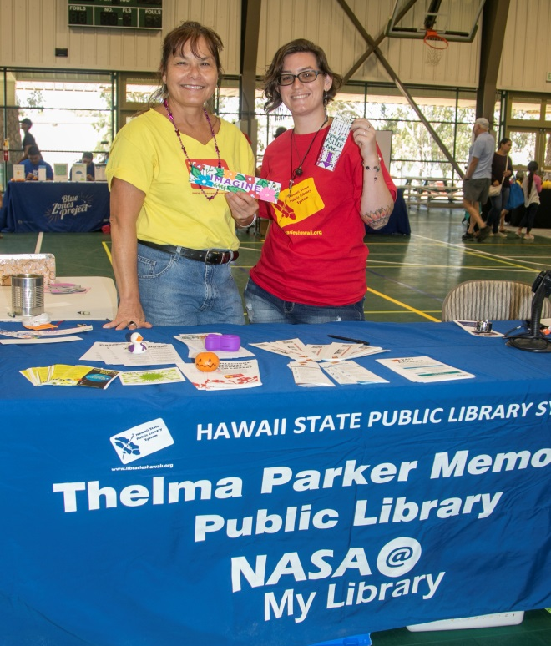
You’re invited
Venue for dialogue
  Scheduling flexibility
  Familiarity, accessibility
  Limited distractions
  Parking
Who to invite
  Representatives relevant to topic
Personalize invitations
  State Dialogue focus
  Chance to share ideas
  Mutually beneficial
  Ask what days and times they are available
Keep it small, keep it manageable!
Notes:
Other considerations = venue & invitations -venue: library meeting room, schools, community centers. -invite = individual to topic: educators, leaders community groups/clubs/organizations, cultural leaders, social services. –invitations: why this person specifically. –smaller numbers = conversation control. (HTP: used library meeting room, evening hours, invited educators and observatory reps., talked to each before inviting)

Slide 7
Execution Isn’t So Scary
Provide participants with a copy of Community Dialogue questions
Facilitator – guides the dialogue
Note-taker – record important discussion points
Assistants – set-up/break-down, sign-in, pass out questions
Translators – as necessary
Food!
Notes:
-Provide Qs help keep conversation focused.
-Facilitator: keeps conversations relevant.
-Note-taker: person sitting in the room & notes taken on large sheets of poster paper. (HTP did both, various conversation points noted.)
-Assistants: help as needed.
-Use translators as necessary.
-Food- connect and network before dialogue; create an inviting atmosphere.

Slide 8
We’re Here, Now What
Introductions
  people, dialogue topics, goals
Ground rules
  Differing viewpoints are okay
  No right or wrong answers
Guide conversation, keep things on track
  Ask if anyone has anything else to add
  Relate conversation back to question
Who is not at the dialogue but may be able to contribute to the conversation?
Wrap up – thank participants for time and input, no solutions need to be put into place.
Notes:
-introduce people, topic & goals of the dialogue (how lib. can support comm. in X topic.) -ground rules -Guide conversation: redirect if needed. (HTP: went smoothly, some conversation overlap, slight need for redirection, lots of “did we get everything? Anything else to add?”)

Slide 9
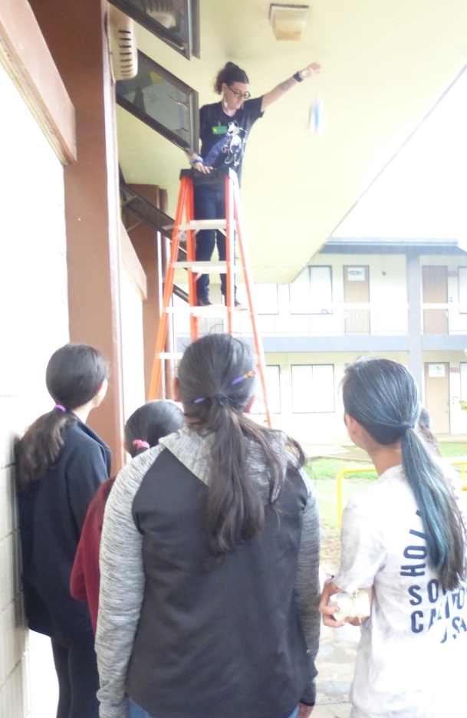
It’s Not Over Till It’s Over
Reflect – look over notes
  Who was not there but could have been
  What topics need more information
  Gaps in dialogue
Use what you learned
  Identify action items and take-aways
  Adjust to fit branch and staff capabilities
Follow-up with participants
  Send thank-yous and notes from Dialogue
  Ask about further input
  Update about changes
Notes:
-process/ reflect. -look over the notes; useful topics/ can be implemented. –adjust to fit branch/staff needs. (HTP: liked idea of afterschool science club, hard to fit with staffing and schedule, instead science games/toys, activities. Increased community presence =outreach events! Invite experts: (OMSI) Oregon Museum Science and Industry, virtual presentations).

Slide 10
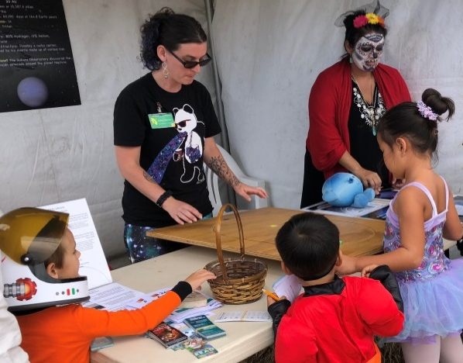
Actually, It’s Never Over
Implement changes
  Entirely new or working from existing base
  Evaluate impact of changes
Adjust over time
  Learn from experience
Foster relationships formed during Dialogue
  Collaborate
Identify topics for future Community Dialogues
Changes in community mean changes in libraries
Notes:
-changes take time and planning (HTP program email list = teachers not parents). -build upon old or create new. -adjust over time before reaching its full potential (HTP: ready for mobile card signup at outreach, forgot cards! But, increased new cards on days of outreach events. More NAML participants – learning new technology/ activities for programs). –collaborate on projects. (HTP collab. With observatories, working on connecting w/ sci teachers: bees?). –changing communities = changing libraries.

Slide 11
Resources
American Library Association. (2018). Libraries Transforming Communities: Models for Change.
  http://www.ala.org/tools/librariestransform/libraries-transforming-communities/ltc-models-for-change
Community Tool Box. (2019). Leading a Community Dialogue on Building a Healthy Community.
  https://ctb.ku.edu/en/table-of-contents/assessment/assessing-community-needs-and-resources/community-dialogue/main
STAR Net Libraries. (2019). Community Dialogues – a guide for public libraries
  https://www.starnetlibraries.org/resources/community-dialogues/

Slide 12
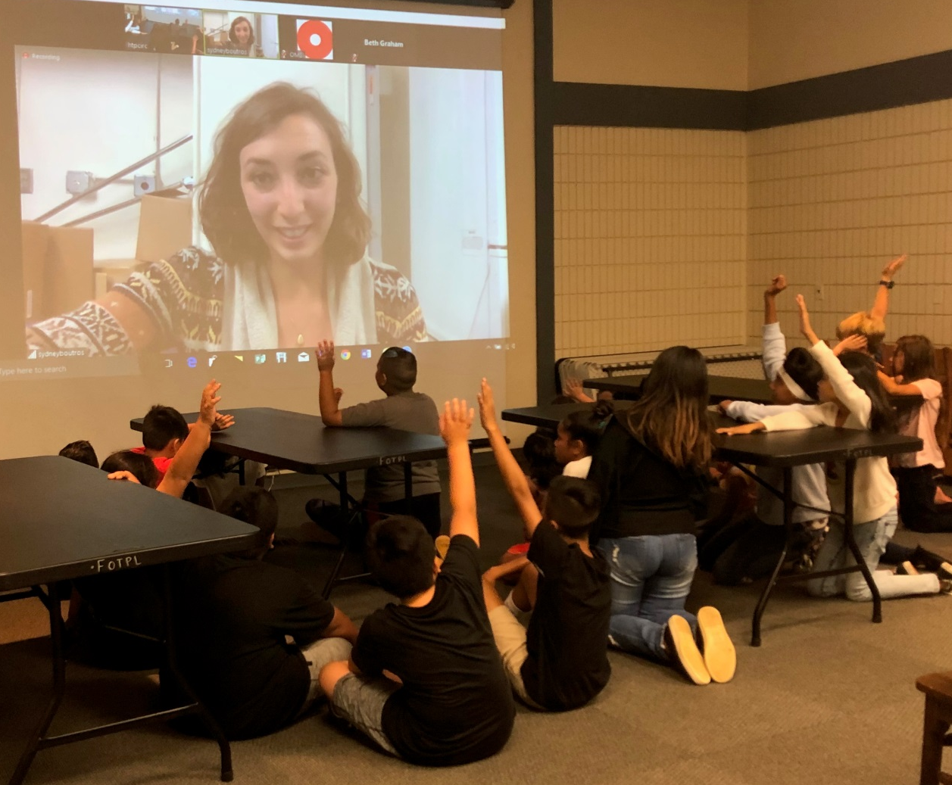
Questions?

Slide 13
Mahalo!

