Slide 1
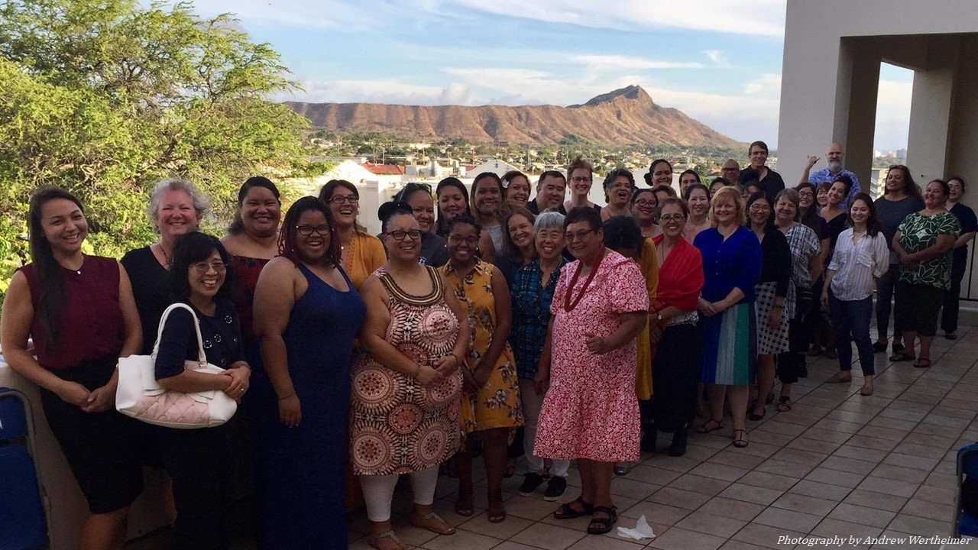

Collaborating across the Isles:
Tracing the cross-pathed footprints of public librarianship in Hawaiʻi
A public librarian professional development program in Hawai’i
Vanessa Irvin
Sarah Nakashima
Library and Information Science Program
University of Hawaiʻi at Mānoa
Hawaiʻi Library Association
November 11, 2019

Slide 2

Aloha
In this moment, we’d like to acknowledge and honor the ancestors of everyone in attendance here today. Thank you for being here, we appreciate your interest and time.
Mahalo to all Hui 'Ekolu participants for their ongoing commitment and trust of this uncharted “journey of practice” called “Hui ‘Ekolu” that will serve as a historic contribution to the edification
of public librarianship.
Hawai‘i State Public Library System (HSPLS)
Nā Hawai‘i ‘Imi Loa, Native Hawaiian LIS professional association (NHIL)
Chaminade Sullivan Family Library
Hui ‘Ekolu Advisory Council

Slide 3
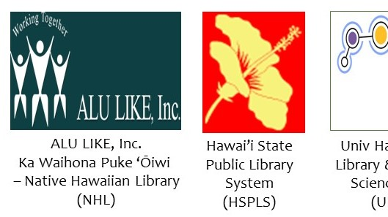

The story

Slide 4
The story
2015-2017 Pilot Study (LINQ)
  Visited 38 of 50 (at the time) HSPLS branches, across the state
  Interviewed 16 branch managers
  Convened community of practice online 9 months
We learned
1| There is an issue of being “too busy” to self-care with professional development.
  The question arose: How do we unbusy the busy?
2| There are not 1, but 2 public library systems in Hawai‘i who are seemingly disconnected from one another, mainstream (HSPLS) and Hawaiian (ALU LIKE)
  The question arose: How do we connect across the LIS career span to learn from one another? To support one another in the services we provide?

Slide 5
The story
2017-2018 Hui Study
  Consulted with HSPLS administration.
  Consulted with ALU LIKE administration.
  Consulted with UHM LIS Program administration.
We asked: How do we, come together in a sustainable way to learn from one another as a community of practice?
Centers Hawaiian
values & praxis
within traditional
LIS practices
across the islands,
across organizations
over time,
ongoing,
together

Slide 6
The story
Hence, “hui ‘ekolu” = the “three groups”
  What does NHL need that HSPLS can provide?
  [ professional ]
  What does HSPLS need that NHL can provide?
  [ para-professional ]
  In what ways do LIS students benefit from the whole experience of working with LIS professionals within a specific cultural context? [ pre-service ]
All in all,
how do we,
as LIS professionals,
learn, grow, and develop,
with one another, together?

Slide 7
The story
PURPOSE
OF
HUI ‘EKOLU
Hui ‘Ekolu seeks to solidify the three groups that provide public library services for Hawai’i
as one collaborative community anchor entity guide
by a symbiotic relationship between all that honors, cares, and respects public librarianship as a community-based practice and service specific and unique to native/indigenous contexts.

Slide 8
The story
GOALS
OF
HUI ‘EKOLU
Mentorship:
LIS students
Continuing Education:
NHL staffers
Professional Development:
HSPLS librarians
Communities of Practice:
All Hui ‘Ekolu participants
Broad Impact:
LIS professional development curriculum and model

Slide 9
Hui ‘Ekolu –
the three groups
………..kinda
Notes:
ACKNOWLEDGEMENTS
-- Speak about our journey thus far, and what we are here to achieve.
-- Pass around social media contact sheet.
STAKEHOLDERS
Valerie Crabbe, Director, Ka Waihona Puke ‘Ōiwi – Native Hawaiian Library
Stacey Aldrich, State Librarian and Director, Hawai'i State Public Library System
Rich Gazan, Professor and Chair, University of Hawai'i Library and Information Science Program
CONSULTANTS
​AnneMarie Pikai, Librarian, President, NĀ HAWAIʻI ʻIMI LOA - Association of Hawaiian Information Professionals (Hui 'Ekolu cohort training)
Sharon LePage, Director, Sullivan Family Library, Chaminade University of Honolulu
Rae-Anne Montague, Director of Grassroots Fundraising at University of Illinois at Urbana-Champaign (project assessment and evaluation)
ADVISORS
Mahealani Merryman, Founding Librarian and Director of Ka Waihona Puke ‘Ōiwi – Native Hawaiian Library, current Lelekamanu Program Director, Papahana Kuaola
Keikilani Meyer, Librarian, Hawaii & Pacific Collection, Sullivan Family Library, Chaminade University of Honolulu
Violet Harada, Professor Emeritus, University of Hawai'i Library and Information Science Program
Loriene Roy, Professor, School of Information, University of Texas at Austin
Felton Thomas, Executive Director and CEO, Cleveland Public Library, Past-President (2016-2017), Public Library Association

Slide 10

ALU LIKE employs cultural practitioners who
work the Native Hawaiian Library’s locations
on O‘ahu, Moloka‘i, Maui, and Big Island.
ALU LIKE brings authentic culture.
ALU LIKE needs library skills.
ALU LIKE, Inc
- Ka Waihona Puke
‘Ōiwi - Native Hawaiian
Library
But: what does ALU LIKE need that HSPLS
can provide?
  Staffing support
  Sustainable support for managing collections
  Active collaboration with wider community
  to share and exchange materials and services

Slide 11

Hawai‘I state public library system (hspls)
HSPLS employs professional librarians who manage 51 branches across the state; there are branches located near ALU LIKE locations.
HSPLS brings library skills.
HSPLS needs authentic culture.
BUT: What does HSPLS need that ALU LIKE
can provide?
  Staffing support
  Cultural tools for working with native public
  Authentic programs
  Organization of collections that honors Hawaiian ways of being and knowing

Slide 12

University of Hawai‘I at Mānoa library and information science program (UHM LIS)
UHM LIS educates citizens to become professional librarians. Most UHM LIS students become those who manage the HSPLS branches across the state. UHM LIS also graduates a considerable community of Hawaiian librarians.
UHM LIS students bring new generation knowledge.
UHM LIS students need front line mentorship.
BUT: What does UHM LIS need that both ALU LIKE and HSPLS can provide?
  Mentorship
  Front line experience of library services to native communities
  Model of cross-organization partnerships

Slide 13
THE HUI
ADMIN
KAIMUKI
MILOLI‘I-KONA
MOLOKA‘I-HANA
WAIANAE
COAST
ADVISORY
COUNCIL
NHIL

Slide 14
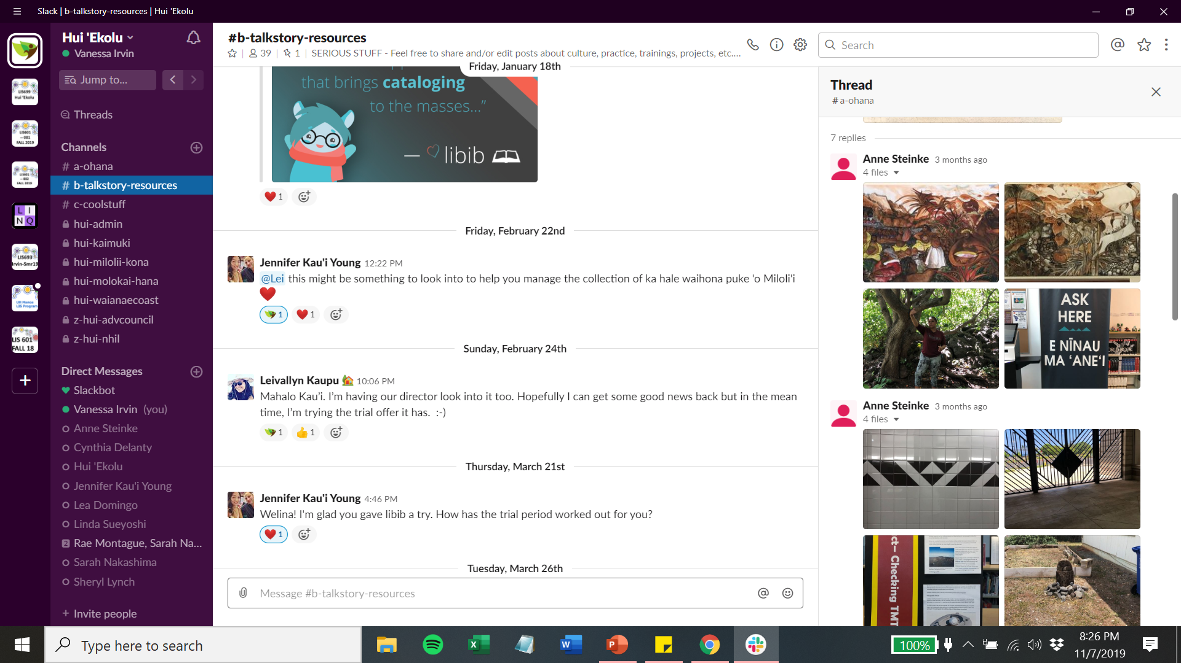

Slide 15
The research lens
Notes:
ACKNOWLEDGEMENTS
-- Speak about our journey thus far, and what we are here to achieve.
-- Pass around social media contact sheet.
STAKEHOLDERS
Valerie Crabbe, Director, Ka Waihona Puke ‘Ōiwi – Native Hawaiian Library
Stacey Aldrich, State Librarian and Director, Hawai'i State Public Library System
Rich Gazan, Professor and Chair, University of Hawai'i Library and Information Science Program
CONSULTANTS
​AnneMarie Pikai, Librarian, President, NĀ HAWAIʻI ʻIMI LOA - Association of Hawaiian Information Professionals (Hui 'Ekolu cohort training)
Sharon LePage, Director, Sullivan Family Library, Chaminade University of Honolulu
Rae-Anne Montague, Director of Grassroots Fundraising at University of Illinois at Urbana-Champaign (project assessment and evaluation)
ADVISORS
Mahealani Merryman, Founding Librarian and Director of Ka Waihona Puke ‘Ōiwi – Native Hawaiian Library, current Lelekamanu Program Director, Papahana Kuaola
Keikilani Meyer, Librarian, Hawaii & Pacific Collection, Sullivan Family Library, Chaminade University of Honolulu
Violet Harada, Professor Emeritus, University of Hawai'i Library and Information Science Program
Loriene Roy, Professor, School of Information, University of Texas at Austin
Felton Thomas, Executive Director and CEO, Cleveland Public Library, Past-President (2016-2017), Public Library Association

Slide 16
Research questions
1| In what ways do public library services occur here in Hawai’i, within a Hawaiian native / indigenous context?
2| What are the differences between definition and function of “library” for native Hawaiian libraries vs. mainstream libraries?
3| What are the protocols for culturally competent professional practices for public librarians in Hawai'i?

Slide 17
Research paradigm
1| Research is Ceremony
protocol: there is protocol in building and
sustaining relationships
collectivity: multiple realities exist simultaneously and are all valid
relationality: “bringing people, places, and things together so that they share the same space is what ceremony is all about” (Wilson, 2008, p. 87).
2|Affective knowledge
feelings/emotions are a valid source of knowledge
“life experiences are essential for furthering knowledge” (Schiele, 2002, p. 190).
holistic logic: feeling and thought within the spiritual oneness of human beings.
3| Triangulation of meaning
using body, mind, and spirit as a template to
organize meaningful research
‘ike to see (body), ‘ike to know (mind), ‘ike to reveal (spirit)

Slide 18
Data sample 1 – advisory council interviews
THEMES
Knowledge ∑ = 366
“knowledge” (n= 366)
Library ∑ = 347
“library” (n= 278)
“work” (n= 20)
“learn” (n= 49)
Native ∑ = 322
“Indigenous” (n= 288)
“culture” (n= 34)
Community ∑ = 255
“community” (n= 254)
“aloha” (n= 10)

Slide 19
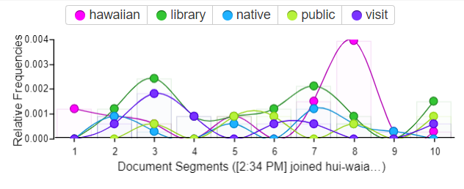
Data – Slack – Year 1
Data sample 2 –
hui surveys
Hui-combined

Slide 20
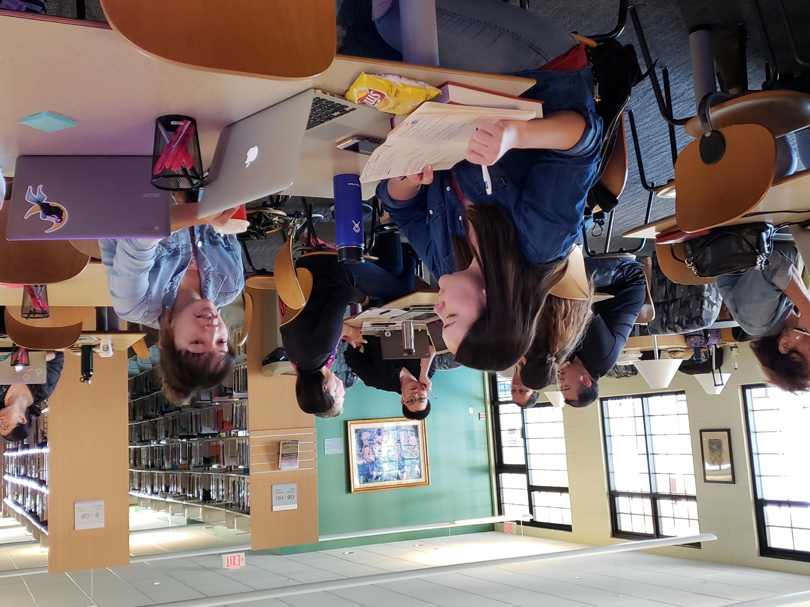
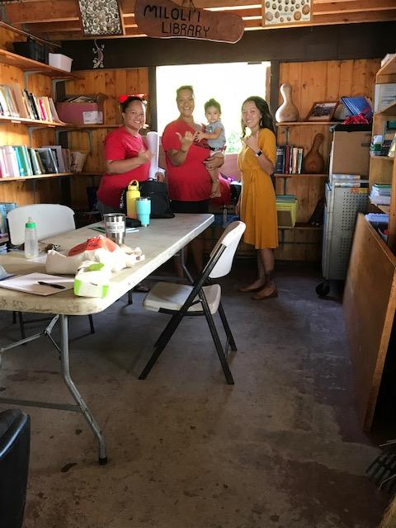
OUTCOMES – year 1
Librarianship as a community of practice is: RELATIONAL

Slide 21
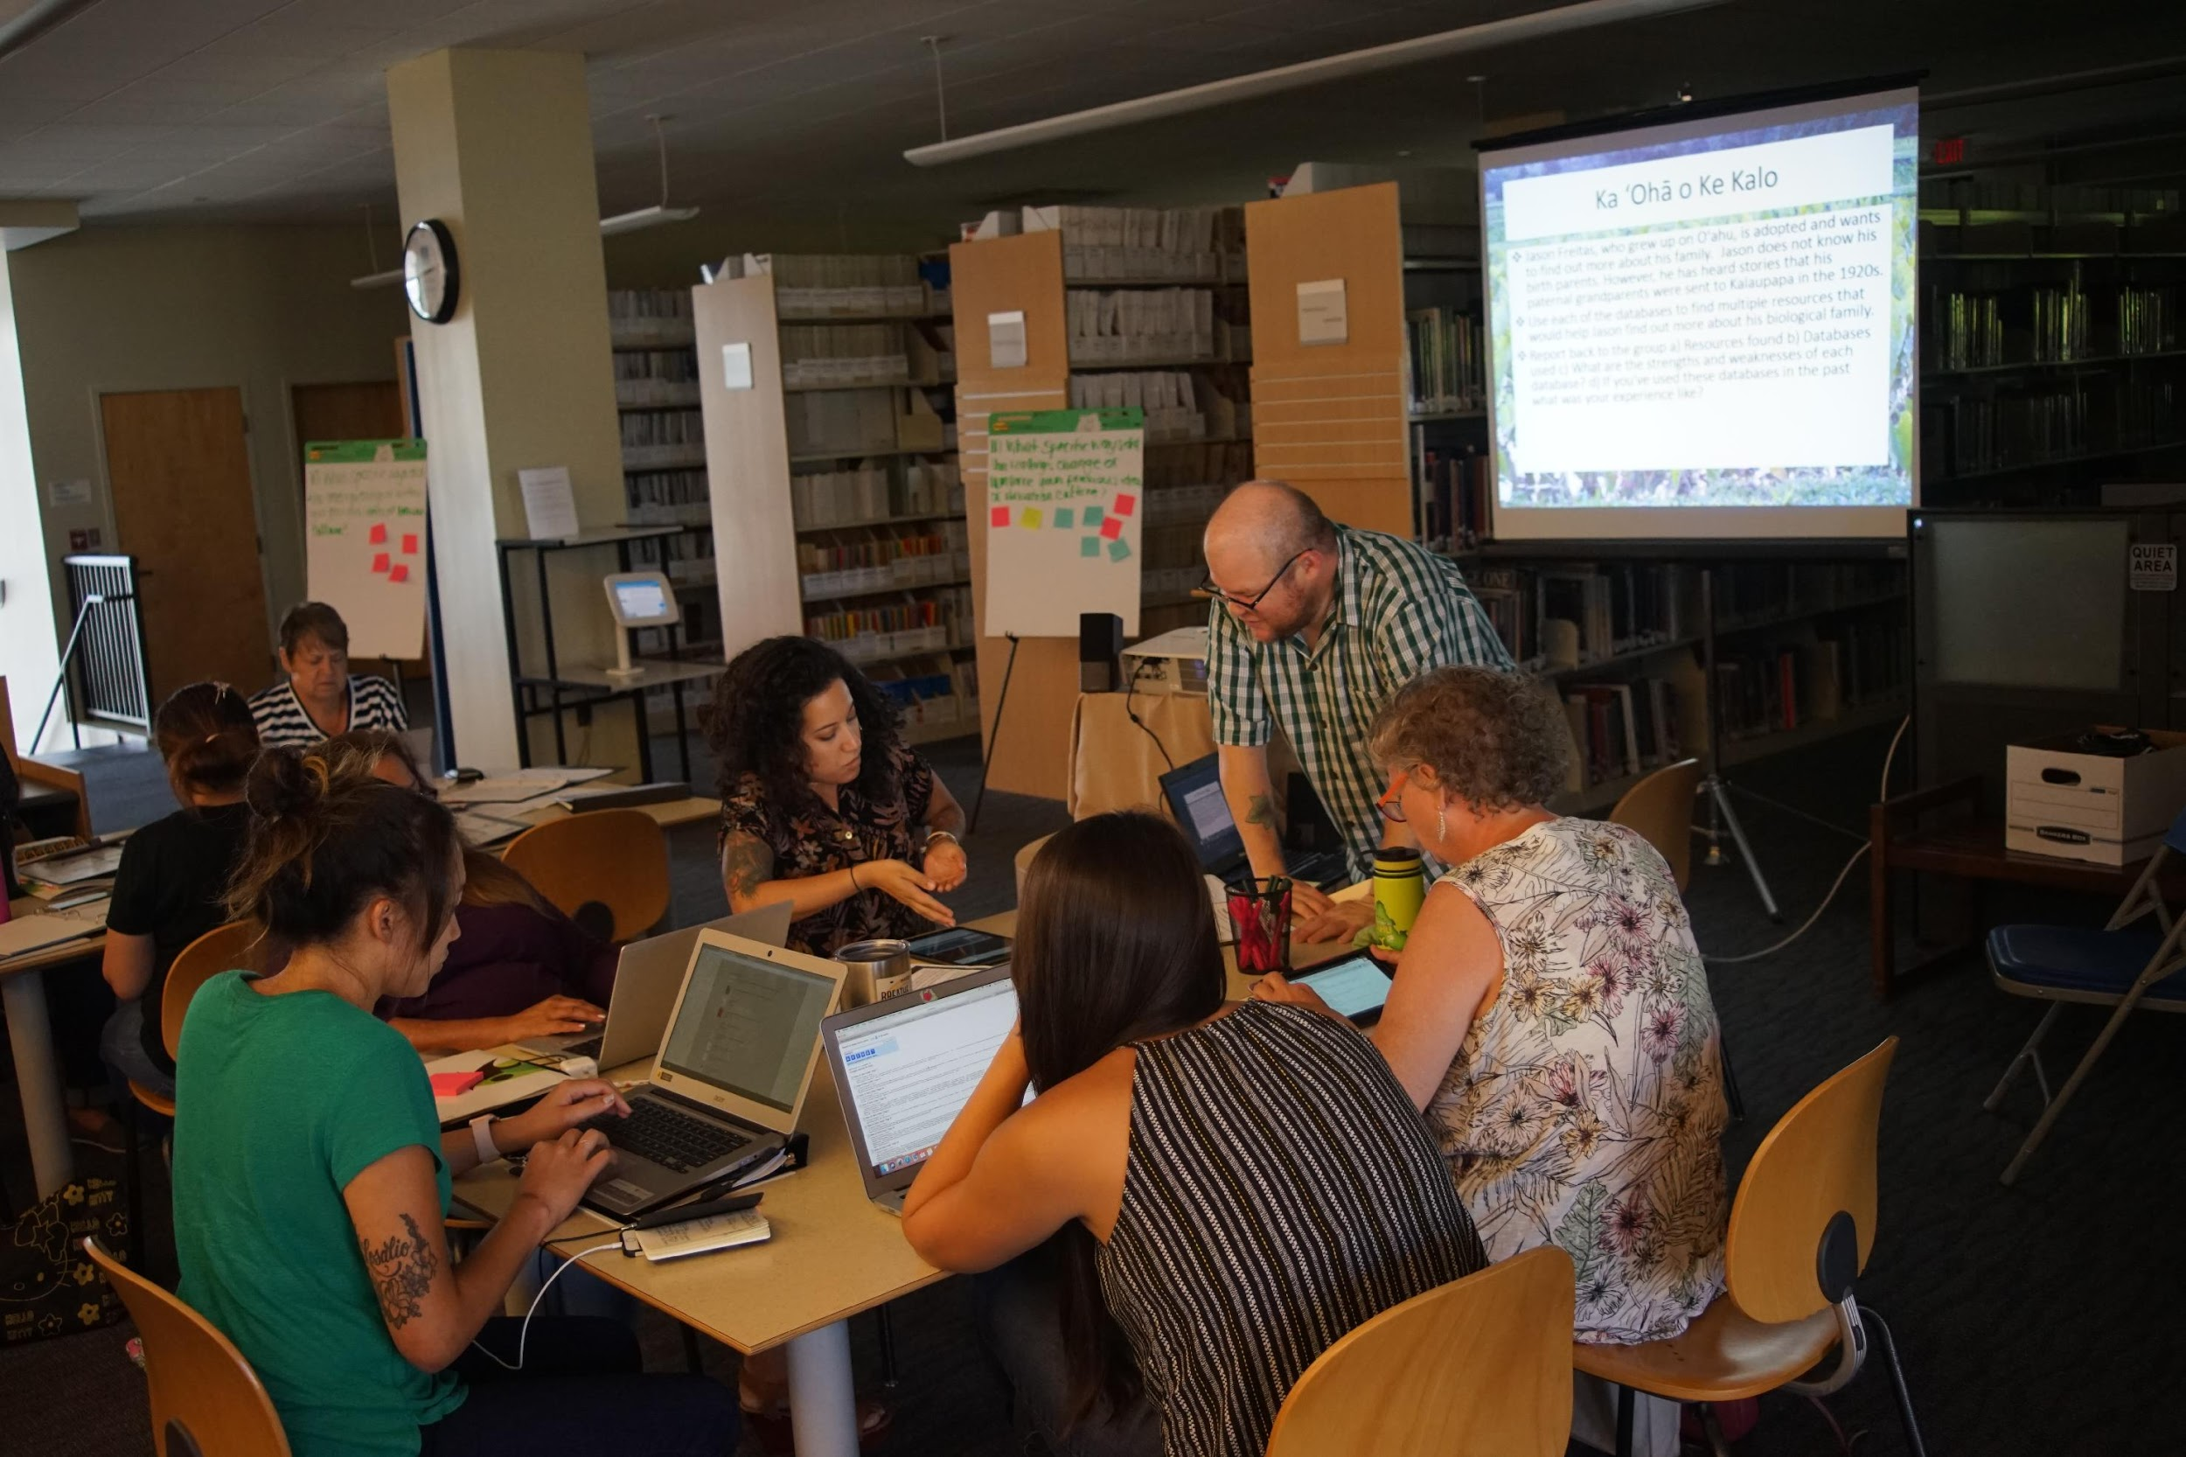
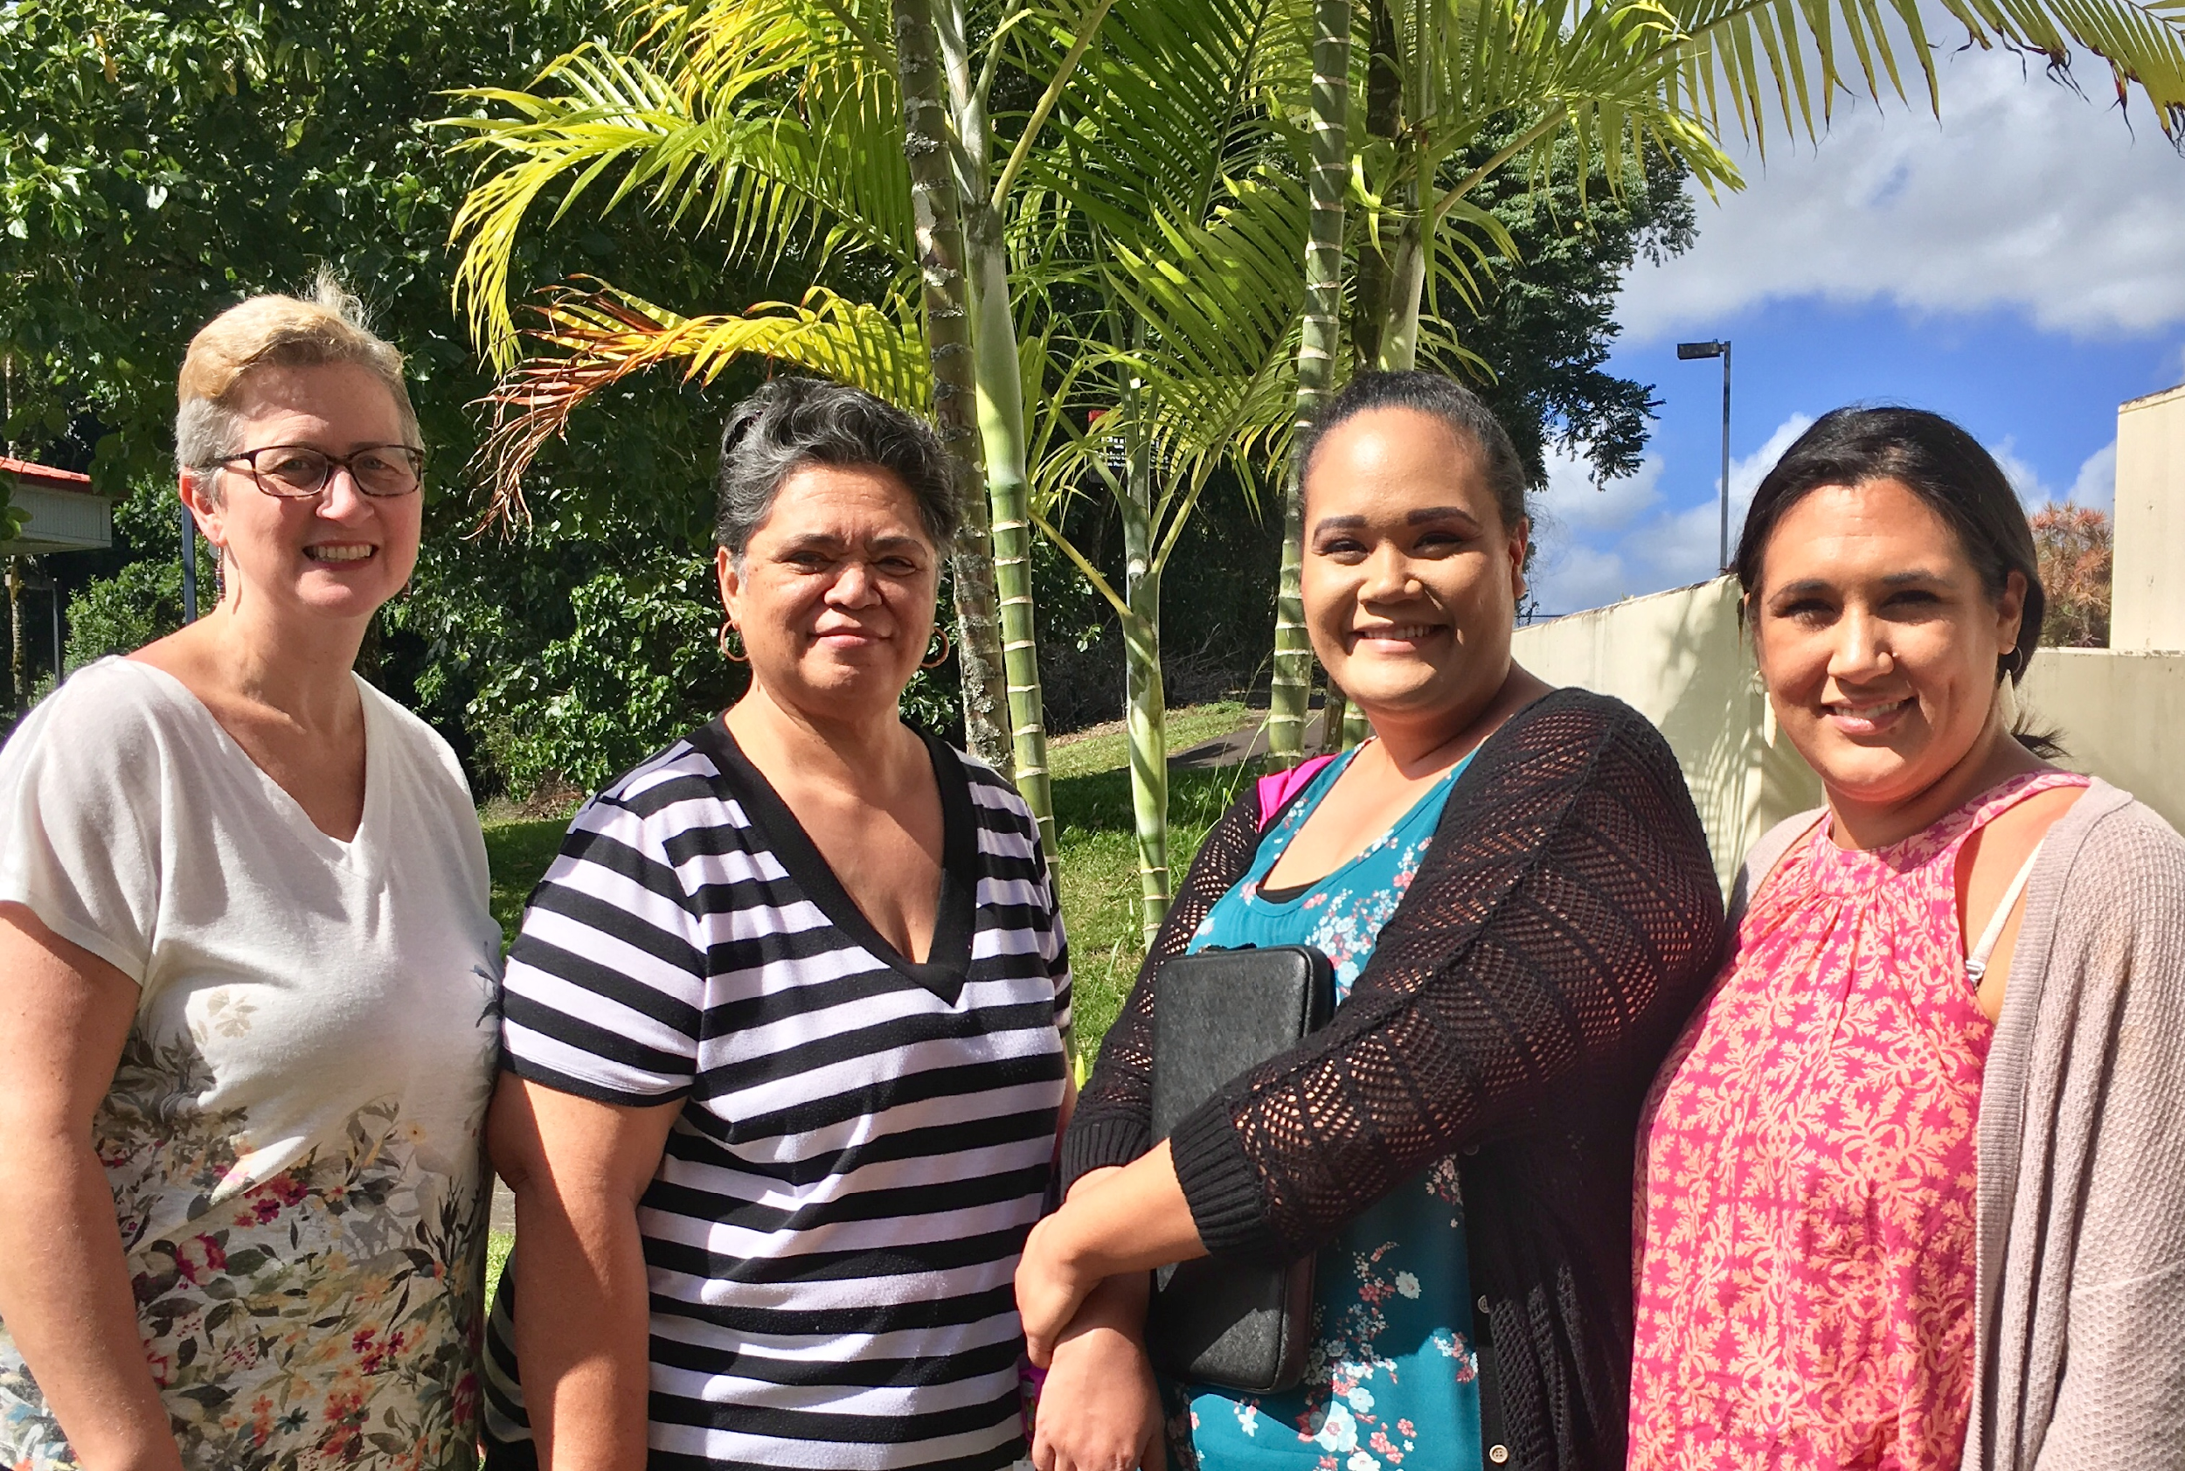
OUTCOMES – year 1
Librarianship as a community of practice is: EXPERIENTIAL

Slide 22
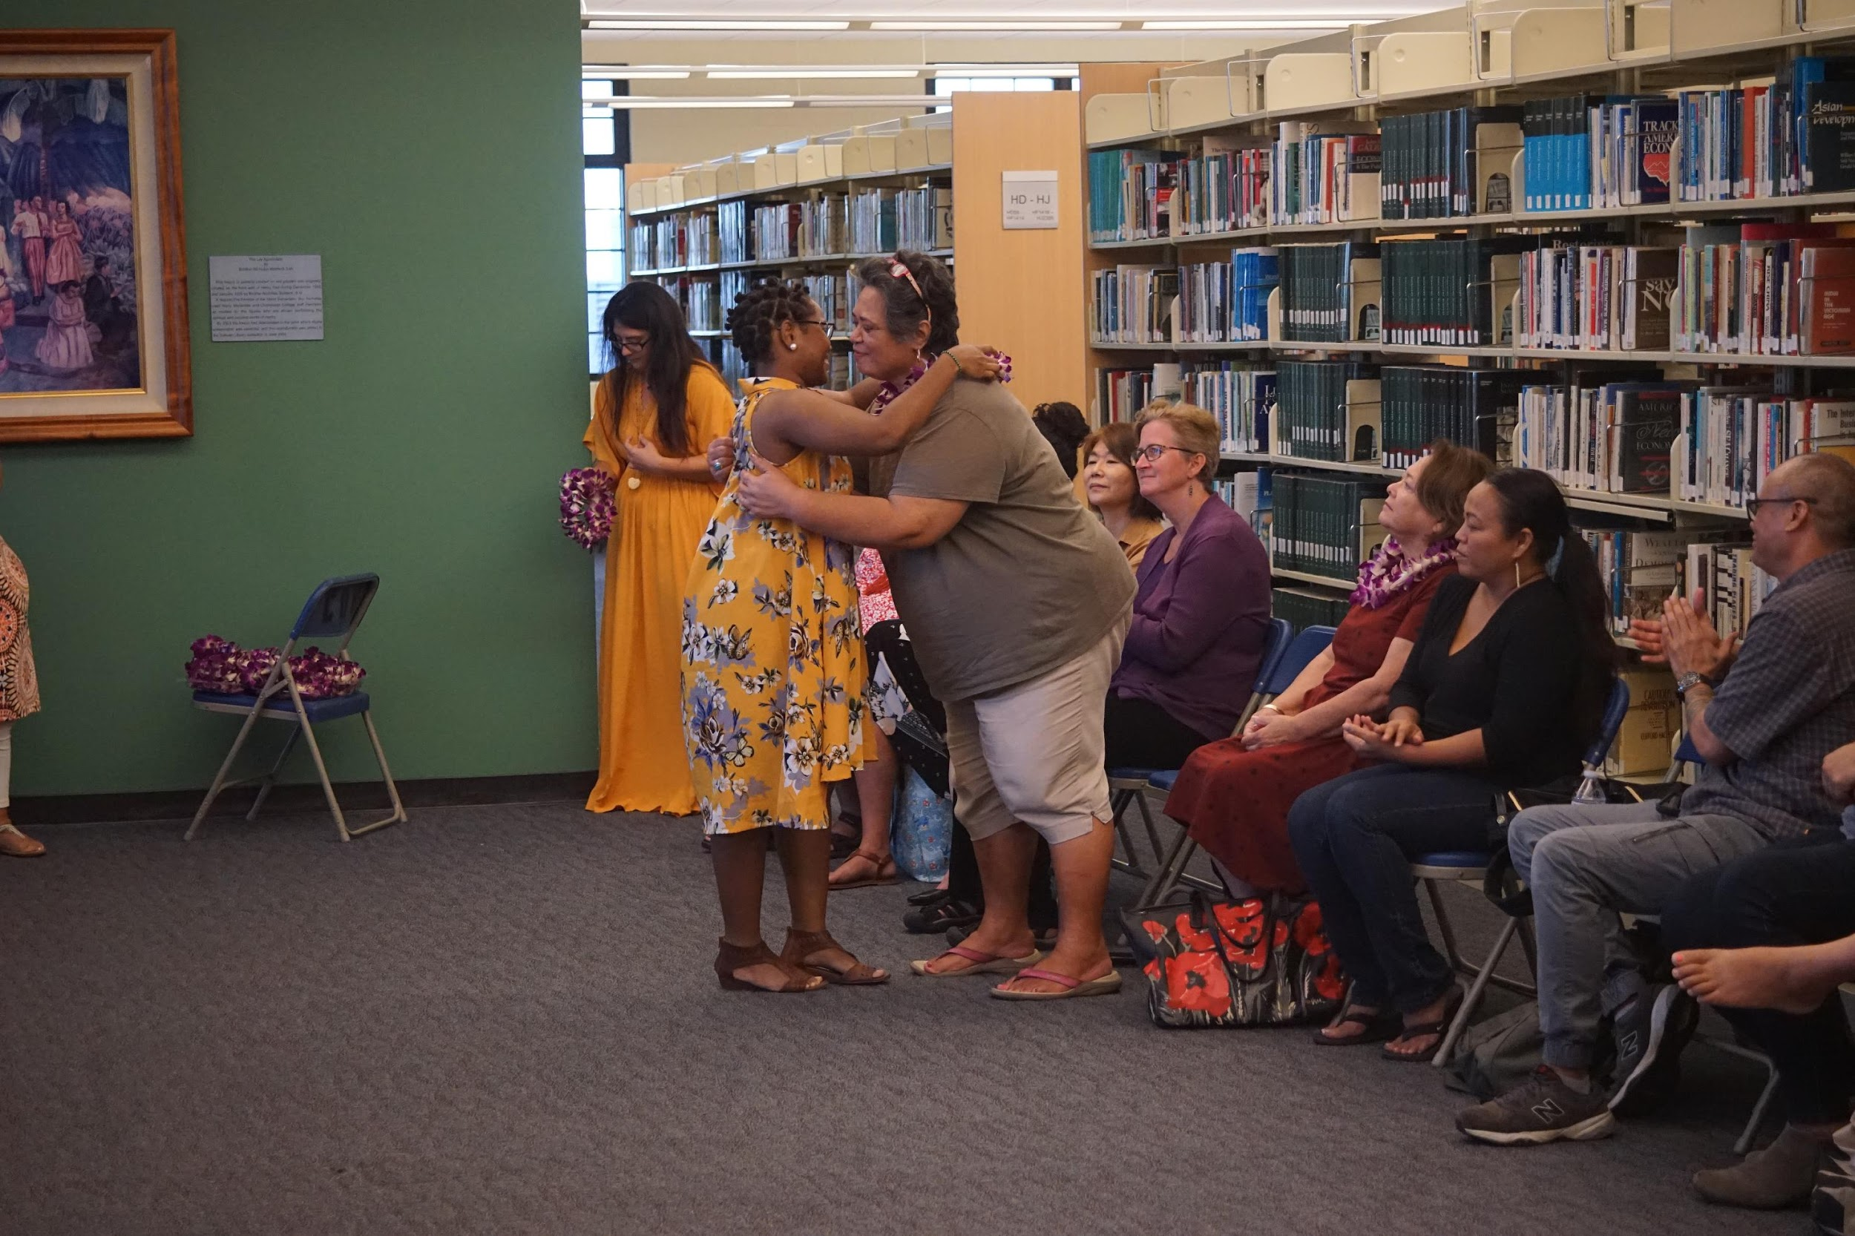
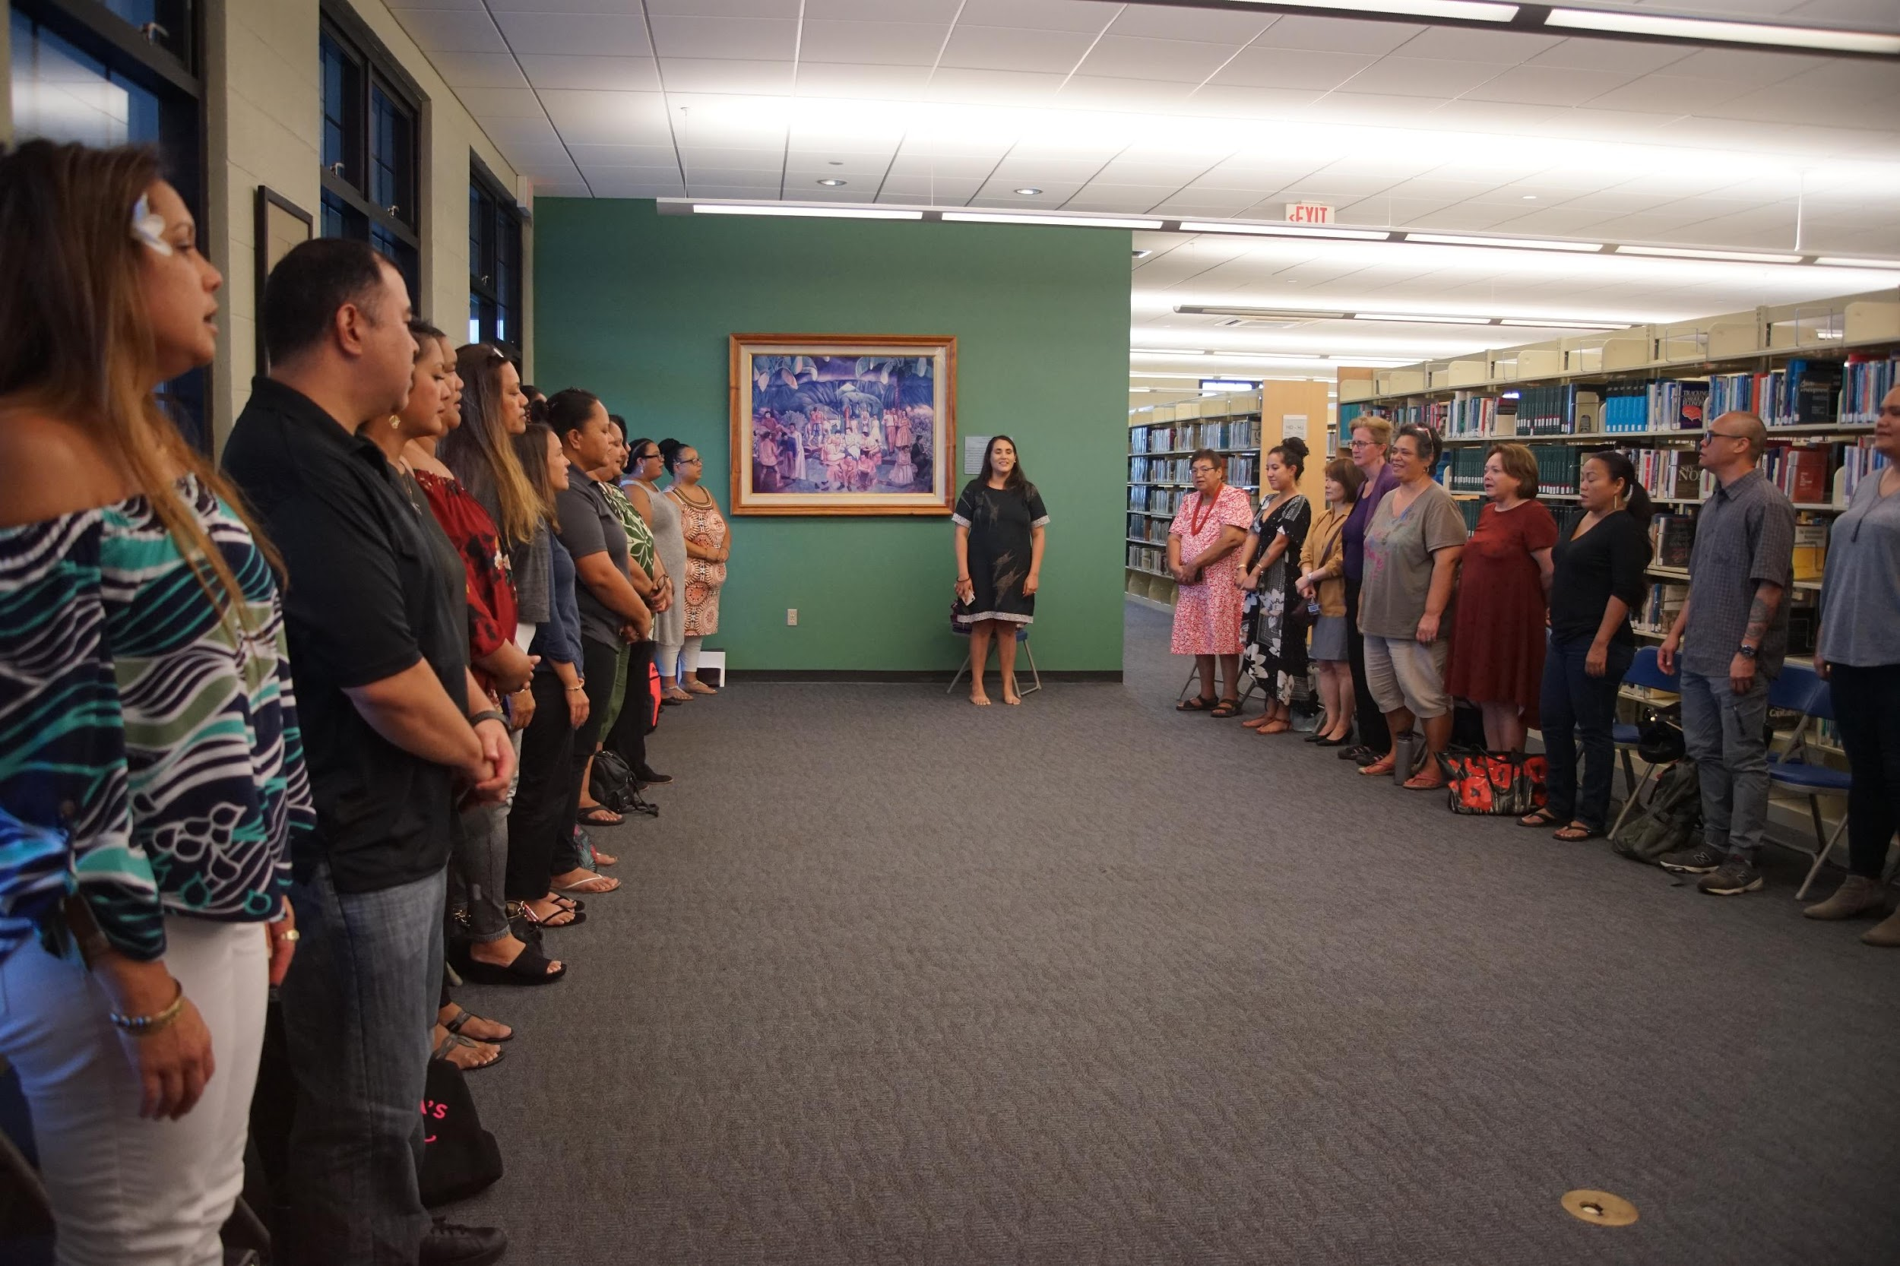
OUTCOMES – year 1
Librarianship as a community of practice is: CEREMONIAL

Slide 23
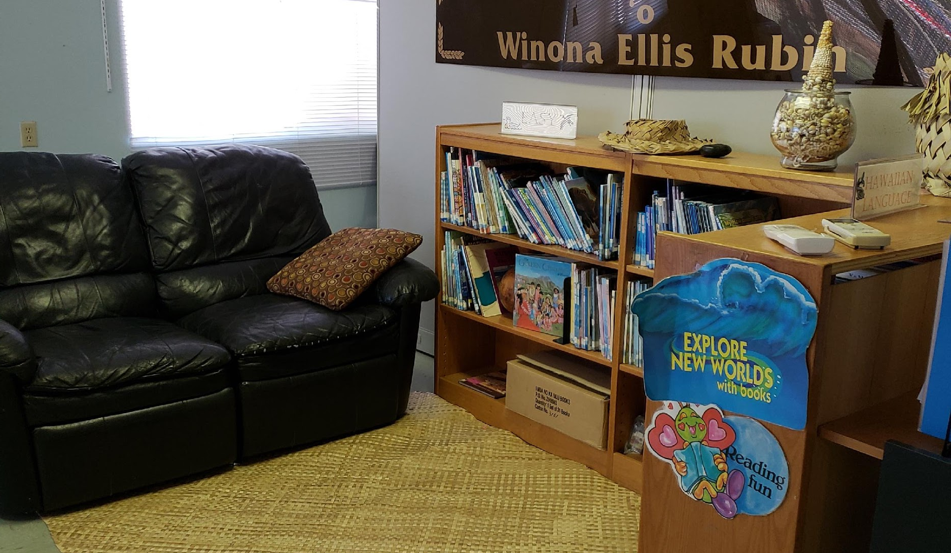
New questions –
What is a Hawaiian library?
  What does a Hawaiian library
  look like?
  How is a Hawaiian library
  arranged?
  What is a Hawaiian library’s
  mission / vision / function?
  Who has access to a Hawaiian
  public library? Why? Why not?
  What information needs can
  Hawaiian libraries fulfill for the
  Hawaiian public ?

Slide 24
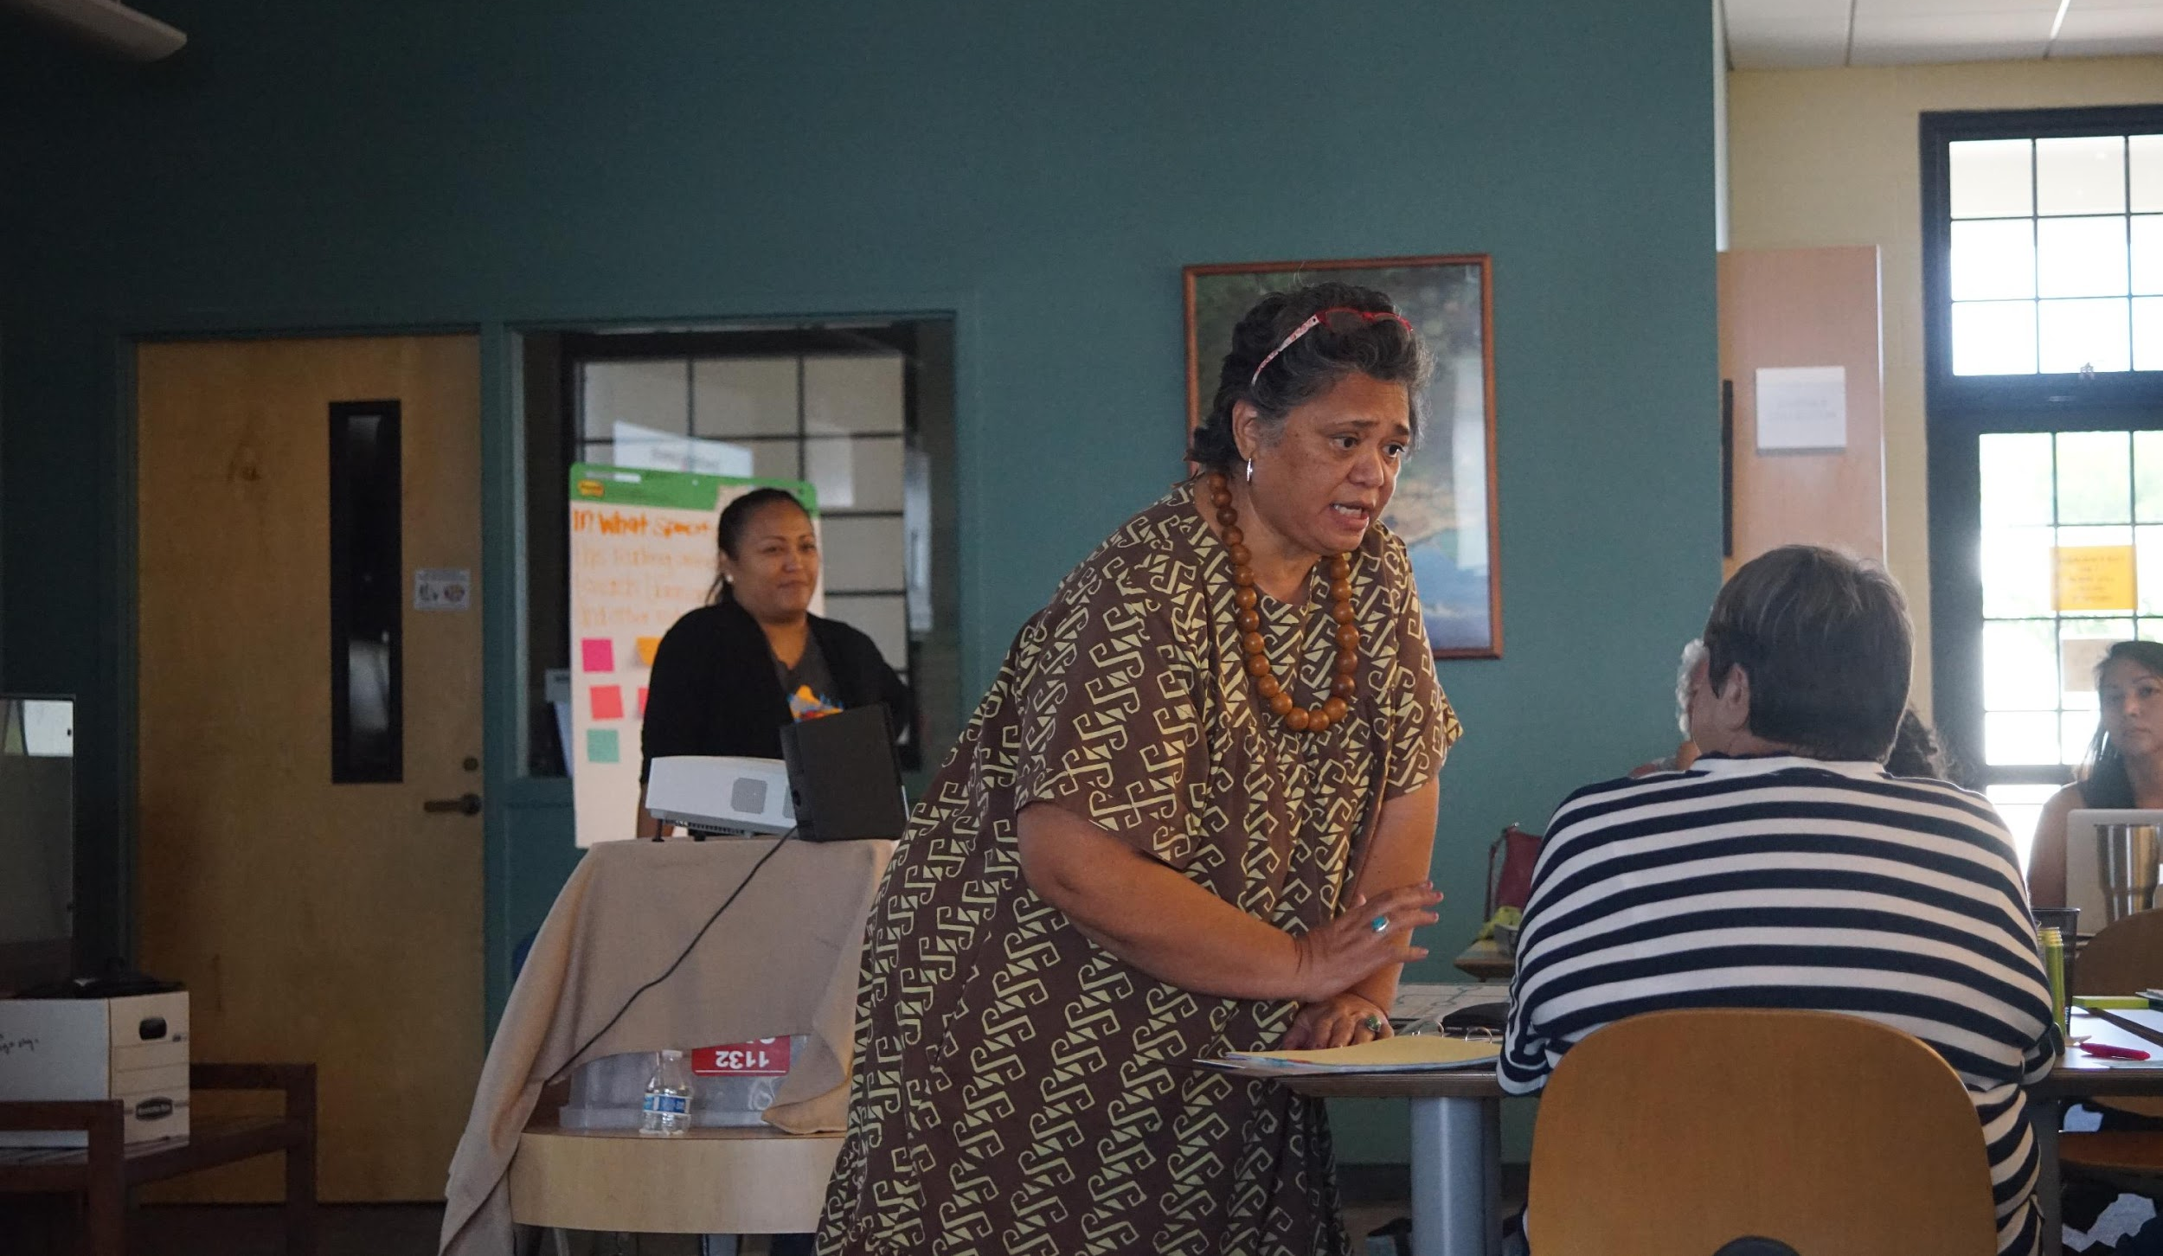
New questions –
What is Hawaiian librarianship?
  What are the protocols for being a librarian for the Hawaiian public? MLIS or nah?
  What do librarians need
  to know in order to best serve the Hawaiian public?
  What is 'ike for Hawaiian librarianship?
  What does learning and knowledge and experience look like feel like be like for public librarianship within
  an Indigenous context?

Slide 25
conclusion
WHERE WE ARE NOW – YEAR 2
WE ARE ASKING MORE QUESTIONS, SEEKING TO UNDERSTAND MORE DEEPLY:
How do we center human interaction within these spaces and honor the relationship that is foundational to the information need.
Ways in which cultural values informs professional practice
Maybe for next hālāwāi - have each hui affirm what is valuable for one another
How do we have a model of encouragement and further down the road it's how do these entities engage and intersect with their programming

Slide 26
references
REFERENCES
Aluli-Meyer, Manulani. (2006). Changing the culture of research: An introduction to the triangulation of meaning, Hulili 3(1), 263-279.
Schiele, Jerome. (2002). Afrocentricity: An emerging paradigm in social work practice. In Ama Mazama (ed.). The Afrocentric Paradigm (pp. 185-199). UK: Africa World Press.
Wilson, Shawn. (2008). Research is Ceremony: Indigenous Research Methods. Winnipeg: Fernwood.

Slide 27
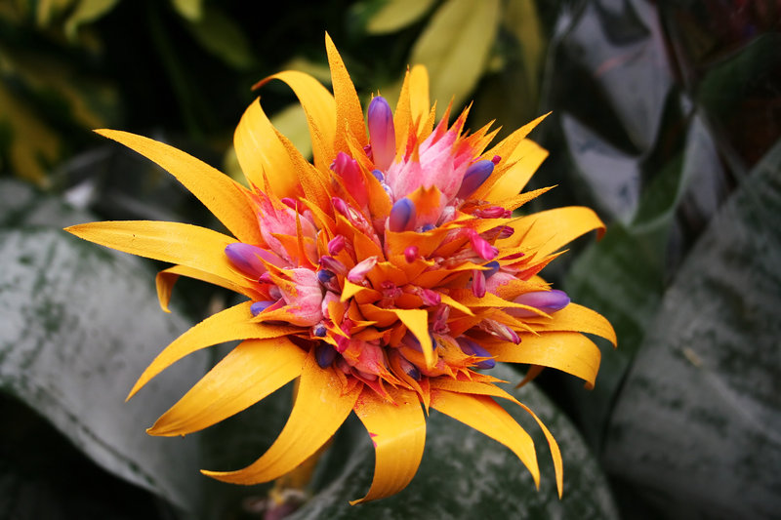
Q & A

