Slide 1
Charting the Legal Systems of the Western Pacific:
Tracking Down Primary Documentation
Vicki Szymczak, University of Hawaiʻi at Mānoa School of Law Library,
Hawaiʻi Library Association, Fall Conference, November 10, 2019.
Notes:
Thank you to HLA for inviting me to speak today. I’m going to talk to you about researching the law as it related to indigenous custom in several pacific island nations. The Pacific region holds a cluster emerging nations that are attempting to reconcile a British styled legal system with indigenous customary law. When I started this project, I thought I would go through each island and have a nice little guide to handout to students. But that proved to be a long project that needed to be broken up. The current legal systems are based on British law, American law and French law. I chose to focus on islands that were formerly recognized internationally as British Protectorates, and one day may get to the other islands. So these included Kiribati, Tuvalu, Tonga, Vanuatu and the Solomon Islands. Each of which has its own path, but also a lot of similarity because of their former status as a British Protectorate.

Slide 2
QUESTION
How is indigenous customary law fused
into the current legal system of Pacific Island Nations?

Slide 3
Received Law
Protectorate
Colony
Independence
English Law:
1893 Order in Council
Notes:
Historical research in this region is fraught with difficulties. British administration in the Pacific region was chaotic. Terminology was not precisely used by the military and political figures, nor did legal commentators carefully observe the legal distinctions between dependency types. There are gaps in dates and in documentation establishing or amending relations between the British government and the ruling chiefs or kings of these island groups. One thing is constant and clear. The current legal system has its roots in something called the 1893 Order in Council which I will get to later.
Typically, a country was first a protectorate. In a protectorate, technically, British Law did not apply to indigenous populations – unless there was an interaction between a British subject and native of the protectorate. This could be employment, business matters as well as civil litigation. Indigenous people did not have a say in the laws that affected their land or how they were taxed. Elders were not consulted.
Eventually, all but the Solomon Islands moved to colony state. A protectorate was moved to colony stage as Britain readied it for independence. As a colony, local leaders were invited to participate in the government. Finally, Britain would published what they called an independence order which, in essence, became the Constitution of each island nation and the laws that governed were incorporated into the new country. The laws carried over are called Received Law or Introduced or Saved Law.
Over time, the thought was the island nation would adopt its own laws and develop its own case law – but a suprising amount of legislation in force upon independence is still on the books today. We are going to focus first on the current laws.

Slide 4
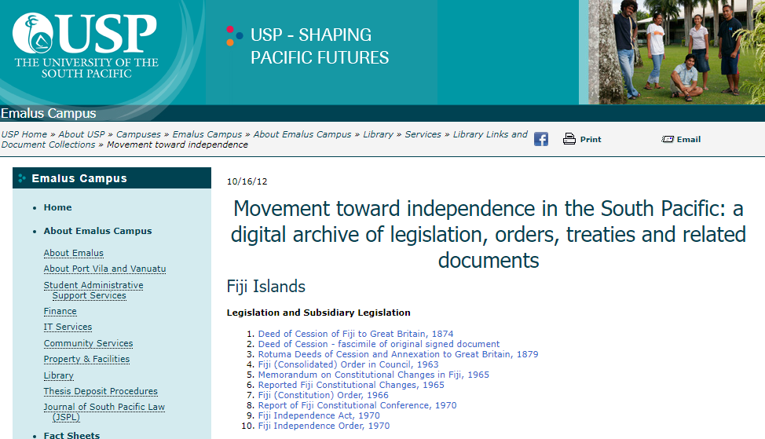

USP Emalus Library: https://www.usp.ac.fj/index.php?id=12228
Notes:
When I first started my project, the USP Emalus Library was a great source for PDF documents from the countries I researched. It was not perfect. It was often down or the PDFs did not have any authentication information attached to it. When I went to update my research for today, I was really sad because they reorganized their web site and all of the links do not work!

Slide 5

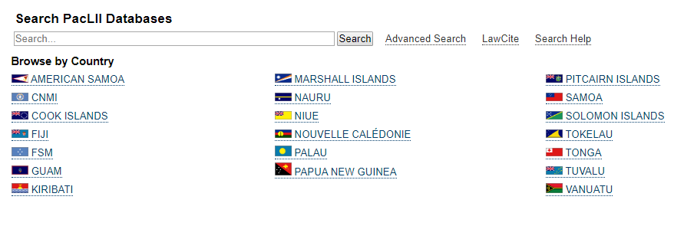
Paclii.org
Notes:
USP is also responsible for maintaining the Pacific Islands Legal Information Institute that provides free digital access to the cases and legislation.

Slide 6
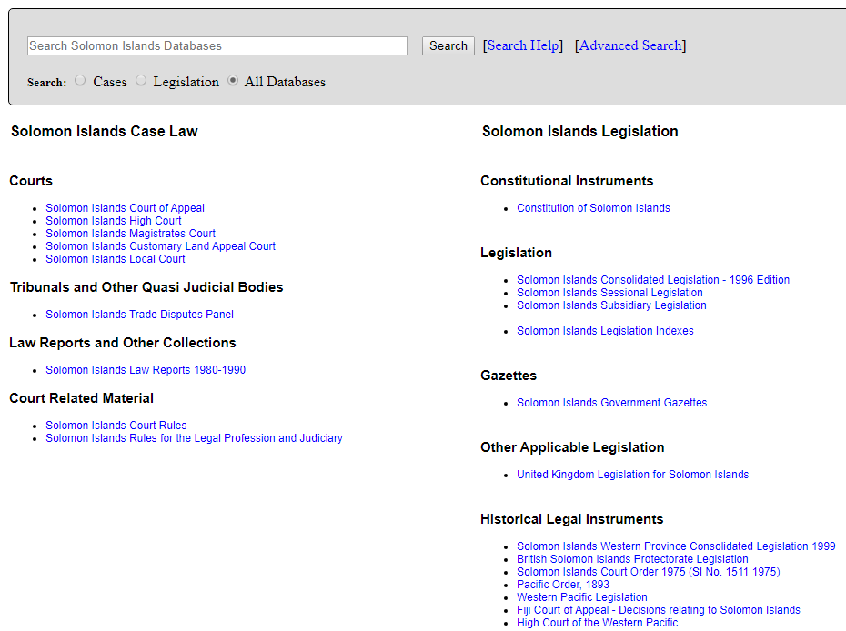
Notes:
So, you can access both case law and legislation. Cases on your left, enacted law on the right. Notice that historical legal instruments are found here. ON the bottom is the 1893 Order which we will look at later. The Gazette is a typical publication in all these jurisdictions. It is the first place you find new legislation but you also find news, proposed legislation, etc. If you want to find particular laws, notice the consolidated laws.

Slide 7
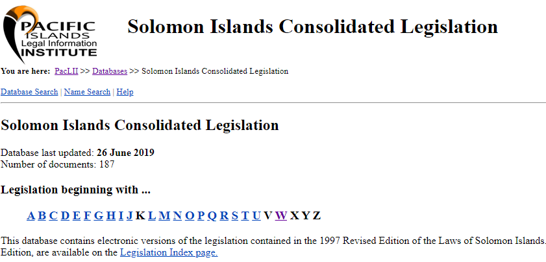
Notes:
What happens in these jurisdictions is they consolidate the laws into one publication, and provide an index to it. So, if you were looking for the Whistle Blower Act of 2018 you would look under W.
What is confusing is that it says the database was updated in June but really, this is just the 1997 edition of the laws. Since the Whistle Blower Act was adopted in 2018, you have to go to the laws of 2018 to find that law. So, nothing since 1997 is in the index or on this consolidated resource. There is another problem. Most of the resources are in HTML format. In the world of law, this is not acceptable as a source citation. We need a PDF, authenticated document.

Slide 8
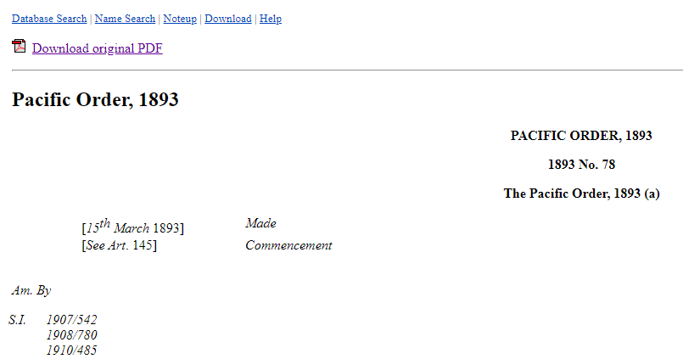

Notes:
So, when I first clicked on the 1893 order to read what it had to say, I was sad to find that it was in HTML! But then I was happy because I saw the PDF click on top. This is where those USP PDF documents wen to. So I clicked on that link.

Slide 9
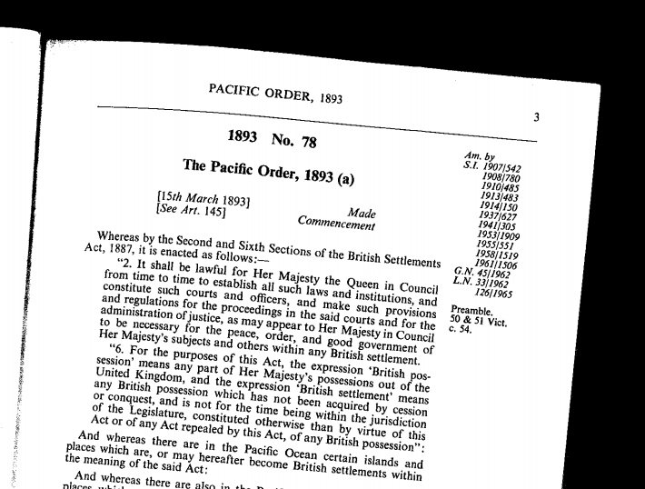

Notes:
And then I was sad again. While this is a pdf, it is sort of sloppy, and I have no idea where it is published. I can guess it is the Statutory Instruments and Orders publication from the UK – but that is only because I am familiar with British resources and it is only a guess. The document is extremely useful though as it points to the amendments since 1893.

Slide 10
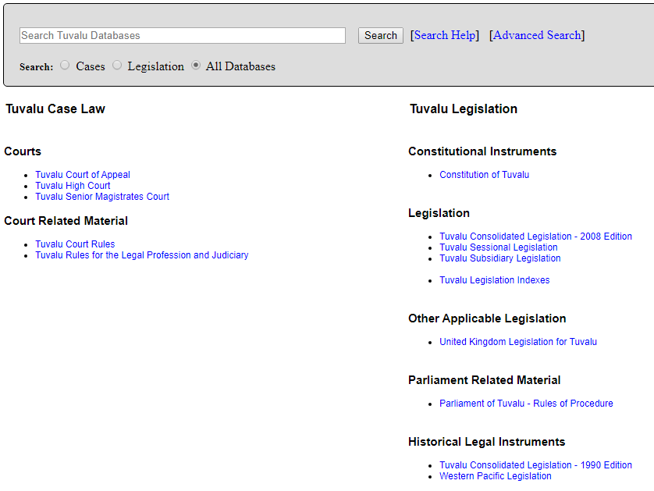
Notes:
Each of the countries is organized a bit differently. Same general structure, but under Historical Legal Instruments we do not see the 1893 Order. Here you would need to know to go to Western Pacific Legislation and look for it. And then, the PDF link is not included either.

Slide 11
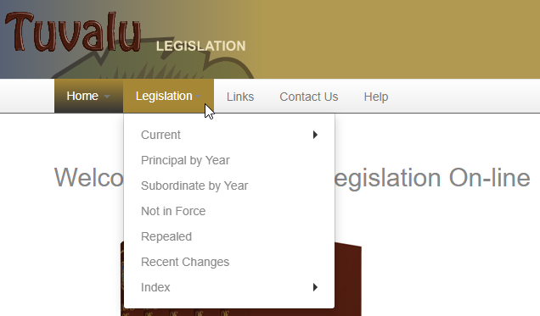
Notes:
The individual countries web sites may be more useful. In the case of Tuvalu it is because you can see what laws have been repealed over the years as well as what is current. The Solomon Islands Legislative Site is not as useful.
Fortunately, to get back to my original question, the Constitutions on Paclii is typically in PDF and my answer as to the current status of custom is often found in the Constitution.

Slide 12
Solomon Islands Example
Adopts Acts of the Parliament of the United Kingdom, Orders of Her Majesty in Council, Ordinances, rules, regulations, orders or other instruments having effect as part of the law of Solomon Islands immediately before the appointed day. (Const. Art. 5)
Applies English common law and equity provided it was not inconsistent with customary law.
  Not required to apply English common law and equity after July 7, 1978. (Cheunga v. Tanda)

Slide 13
Tuvalu Example
Constitution is the supreme law.
Adopts Acts of the Parliament of the United Kingdom, Orders of Her Majesty in Council, Ordinances, rules, regulations, orders or other instruments having effect as part of the law of Kiribati immediately before the independence day.
Customary law shall have effect as part of the law of Tuvalu, except to the extent that it is inconsistent with an Act or an applied law.
English common law and equity shall have effect unless inconsistent with custom or Act.
Notes:
Constitution, Independence Order, Laws of Tuvalu Act
Laws of Tuvalu Act, Schedule 1 details how to balance customary law against enacted law and principles of law and equity.

Slide 14
High Commission of the Western Pacific
Protectorate
Colony
1893 Order in Council as Amended by the 1961 Order in Council

Slide 15
Troubleshooting Terminology
Geographic Names
British Legal Terminology

Slide 16
Islands’ Names > Index/
Search Terms
Island Group Name | Protectorate & Colonial Period Name | Current Name
Banks | New Hebrides | Vanuatu
Florida Group | British Solomon Islands | Solomon Islands
Union Islands | Tokelau (Gilbert Islands Group, 1916 to 1925) | Tokelau
Notes:
“A Gazetteer of Obsolete/Alternative Names of the Pacific Islands with their Current Equivalents and A Gazetter of Current Names of the Pacific Islands with their Obsolete/Alternative Names, Part 4 in Bob Langdon, American Whalers and Traders in the Pacific: A guide to records on microfilm (PMB 1978), http://asiapacific.anu.edu.au/pambu/docs/GazetteerObsoleteAlternativeNames.pdf.
Alexander G. Findlay, A Directory for the Navigation of the South Pacific Ocean, 3rd edn (London, 1871); Alexander G. Findlay, A Directory for the Navigation of the North Pacific Ocean, 2nd edn (London 1870); Andrew Sharp, The Discovery of the Pacific Islands, (Oxford, 1960); Edwin H. Bryan, Jr, American Polynesia and the Hawaiian Chain, (Honolulu, 1942): Naval Intelligence Division, Pacific Islands, 4 vols, (Cambridge, 1943-45); H.E. Maude, Of Islands and Men, (~1elbourne, 1969); and Judy Tudor (ed.), Pacific Islands Year Book, 11th edn

Slide 17
British Legal Terminology:
Subjugation Status
British Subject
Protectorate/
Protected State
Colony
Notes:
British controlled islands typically began their official legal relationship with Great Britain as a Protectorate before becoming a colony. The only original Protectorate in existence prior to achieving independence was the British Solomon Islands. A Protectorate is a territory that is subject to a kind of guardianship by another state. The type of Protectorate in place between Great Britain and the Pacific Islands may be referred to as a “colonial protectorate” because it resembled the relationship between Great Britain and its colonies. The High Commissioner of the Western Pacific issued Regulations to govern Protectorate affairs. Colonial Laws Validity Act 1875, 28 & 29 Vict. c. 63 (Eng.).
Terminology and Classification, 6 Hals. Laws of Eng. 417-418, Para. 706 (Lord Mackay of Clashfern, ed.,, 4th ed. 2003).
Parry and Grant Encyclopaedic Dictionary of International Law (John P Grant and J.Craig Barker eds., 3d ed. 2009).
Protected State: A Protected State has an established form of government and head of state. In this type of dependency, the protecting state expresses either prescribed, limited jurisdiction, or no jurisdiction. The internal administration of these territories is left to the discretion of the local governing bodies. Among these jurisdictions only the Kingdom of Tonga was a Protected State of Great Britain for which the High Commissioner of the Western Pacific created regulations. It gained full independence in 1971.
Terminology and Classification, 6 Hals. Laws of Eng., 417-418, Para. 706, (Lord Mackay of Clashfern, ed., 4th ed. 2003).
Colony. Under British law, a colony was defined to include all of Her Majesty’s possessions abroad in which there was a legislative authority that was competent to make laws. The High Commissioner of the Western Pacific through appointed commissioners and governors oversaw colonial government. As the islands’ legal authority, it adopted ordinances that served as the local legislation for the colonies under its jurisdiction. As colonies prepared for independence, the responsibility for rule making shifted from the colonial Governor to island inhabitants through the appointment or election of a legislative council composed of islanders.
Terminology and Classification, 6 Hals. L. of Eng. 416-17, Para. 705 (Lord Mackay of Clashfern ed., 4th ed. 2003).

Slide 18
British Legal Terminology:
Document Types
Prerogative Instruments
Proclamation
Orders in Council
Letters Patent
Queen’s or King’s Regulation
Received/Introduced Law
Notes:
Queens or Kings Regulation were like our regulations. It depended on whether there was a Queen or a King in control of the British Monarchy. That determined what to call it. These were administered by the High Commission.
Though each type of instrument has prescribed purposes, the delineation lines between their uses were not clear during this time period. So that also became confusing. Also, their publication pattern was not consistent. Sometimes, the document would just be a broadside, tacked to a government building. We may never know the full collection of the laws in effect on each of these islands.
Proclamations. Great Britain used Proclamations in the Pacific region typically to establish Protectorates and Colonies, and to alter status from one to the other. Proclamations were made by the crown with the agreement of the Privy Council. The Privy Council records may contain the text of these decrees. They may also be reprinted in the London Gazette or the Statutory Rules and Orders series. Proclamations were often the first evidence of a relationship between Great Britain and an island in pursuit of commercial advantage. As such, you may find copies of Proclamations in the major official and unofficial British treaty collections. Proclamations for these islands appear at the end of each issue of the High Commissioner of the Western Pacific Gazette but you will need to have a date to identify them as there is no subject index.
Order in Council. An Order in Council is the most common form of delegated legislation in this group. It was often employed to extend Acts of Parliament to the English dependencies, and to enact or amend local laws created specifically for that dependency. This type of instrument was also used to establish colonial constitutions. There are two types of Orders in Council. The first type was made by the Queen or King with the advice of the privy council. This brand of Order is very difficult to track down in official publications. The second type was made by the sovereign in connection with statutory authority. This brand of Order required the approval of Parliament. In these cases, the Orders may be found appended to the corresponding annual publication of Statutory Instruments or its predecessor, Statutory Rules and Orders. For the online researcher, digital versions of the Statutory Instruments and Statutory Rules and Orderss do not often include the appendixes. Researchers may also consult the island gazettes, though it will be helpful to know the approximate dates of publication to use them successfully.
Letters Patent. A Letters Patent was issued by the King or Queen to confer a grant a right, appoint officials, create offices, reverse colonial court orders, dispose of land and to detail constitutional process. Outlets for publication are similar to those for Orders.
In addition to the subject matter addressed by these documents, the level of detail will also vary. The Orders and Letters Patent tend to offer more detail while Proclamations resembled announcements rather than a vehicle that offered specifics.
The United Kingdom has made many of its treaty series available online at http://treaties.fco.gov.uk/treaties/treaty.htm.
Prior to independence, the sources of law for BWP islands generally consisted of Prerogative Instruments, Acts of the British Parliament, Regulations, Ordinances and related Subsidiary Legislation issued by the law making authority; subsidiary legislation; English common law and equity, and, to some extent, customary law. As their legal systems became more robust, constitutions were adopted and colonial legislation was enacted becoming added sources of law. Except for the colonial constitutions that were replaced upon independence with new Constitutions, these sources of law were carried over into the new governments. In the literature, this is referred to as “received, “introduced,” or “saved” law.

Slide 19
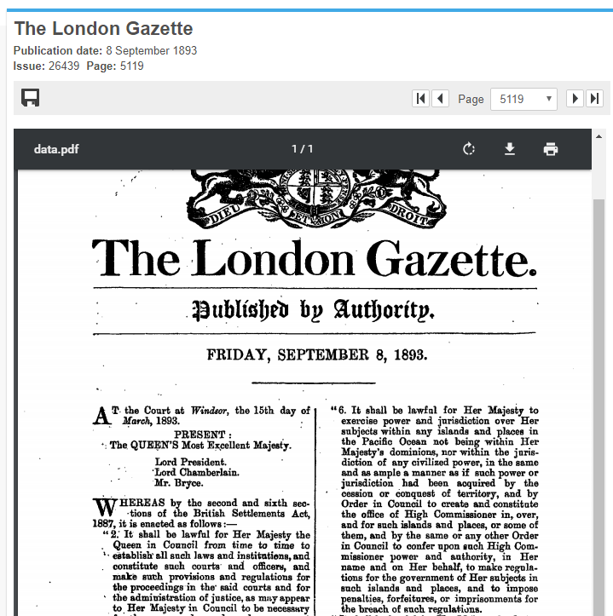
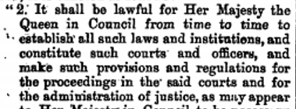
London Gazette: thegazette.uk.gov
Notes:
Britain created its own laws to give it authority to colonize other regions. The British Settlements Act, Colonial Laws Validity Act and especially the Foreign Jurisdictions Act applied to all colonies. They also adopted Pacific Islanders Protection Act, 1875 that was Enacted to prevent removal of indigenous people from their islands without their consent. Section 6 enabled the sovereign to exercise jurisdiction in the Pacific region that was outside of the jurisdiction of a civilized power, as if jurisdiction has been acquired by cession or conquest.
In 1893 Order in Council superseded the 1877 Order. The 1893 Order functioned like an organic act for the islands under its jurisdiction. It provided for the application of British law in the region, a structure for the court system, rules of evidence and civil and criminal trial and appellate procedure, and special procedures for admiralty, bankruptcy, divorce, lunacy and probate.
.

Slide 20
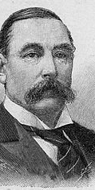
High Commissioner of the Western Pacific
Sir George Michael Thomas O’Brien, 1887-1901, 5th High Commissioner, and 6th Governor of Fiji.
Notes:
The 1893 act replaced the 1877 Act, In 1877, Britain established the High Commissioner of the Western Pacific “ to provide a civil court for the settlement of disputes of British subjects residing in these islands…” Initial motivation behind establishing a British authority in the region was to combat “blackbirding,” a practice where European traders and settlers trafficked Islanders in the Pacific slave trade.
The 1893 Order formed the foundation for these island governments during the first half of the twentieth century until it was superceded by the 1961 Order. It vested judicial, legislative and executive power with the High Commissioner of the Western Pacific, and extended jurisdiction to foreigners and (in many cases) to indigenous residents of British settlements or protectorates that did not have a recognizable form of government to Great Britain.
1893 Order, Article 28 states: Crimes, offences, wrongs and breaches of contract against or affecting the person, property or rights of natives or foreigners committed by persons subject to this order are punishable or otherwise cognizable, in the same manner as if they were committed against or affected the person, property, or rights of British subjects.
From this document, islands developed legal systems unique to their own cultures.

Slide 21
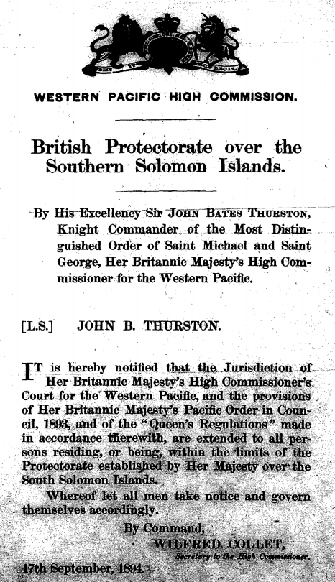
Proclamation Example
Pacific Order in Council, 1893.
Notes:
This is an example of a Proclamation. This one announcing a protectorate over several of the Solomon Islands. The authority it relied on is that 1893 Order. For my research, this is the type of document I need to cite to. It is a PDF original primary source of law. So to find this type of document I have to check several resources listed on your handout. It is pain staking.

Slide 22
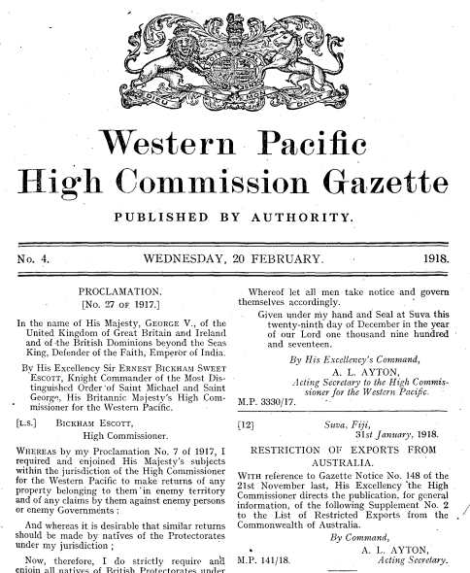
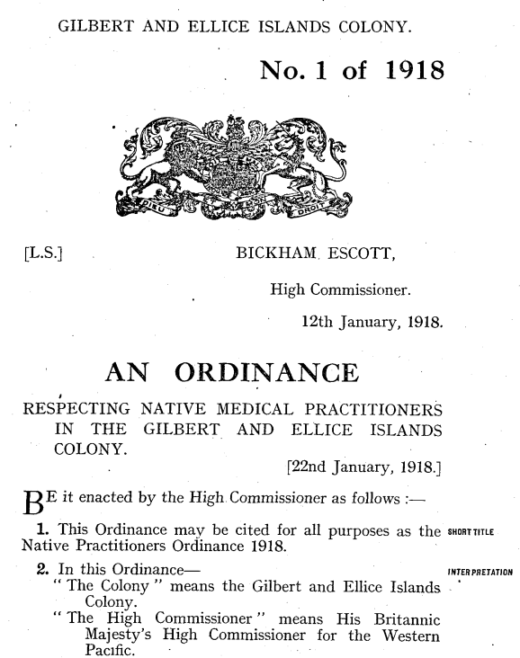
Gazettes
Notes:
If the legislation came from the High Commission it was a regulation and if it was generated by the local governor or legislative council, it was an ordinance. The former could be found in the Commission Gazette, the latter in the Island Gazette.

Slide 23
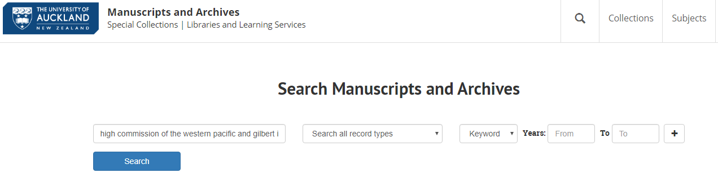
https://archives.library.auckland.ac.nz/
Notes:
The Western Pacific Archives at the University of Auckland holds the records of the High Commissioner of the Western Pacific (1875-1978), New Hebrides British Service (1902-1975) and the British Commissioner and Counsul for Tonga (1862-1968). In addition to correspondence, administrative records and policies, researchers will find information on the revisions of laws, handwritten notes on civil and criminal legal cases, land and family history records (which can be important in the succession of property), and the legal status of indigenous people.

Slide 24
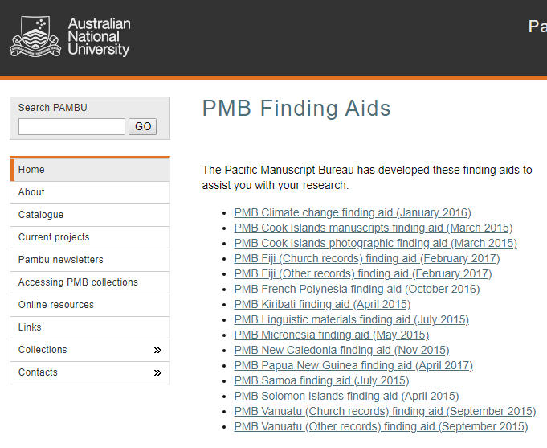
Pacific Manuscript
Bureau
http://asiapacific.anu.edu.au/pambu
Notes:
Pacific Archives and Manuscripts Bureau is an online catalog of unpublished records of organizations, manuscripts, diaries, files, minutes, correspondence, and research papers. Catalog points you to microfiche available at Hamilton Library at the University of Hawaii at Manoa, Library of the University of California at San Diego, Yale University Library, and University of Michigan Library at Ann Arbor. This is very useful – especially the personal records of the Governors appointed to the islands. They have drafts of documents that may not otherwise be found in the published sources.

Slide 25
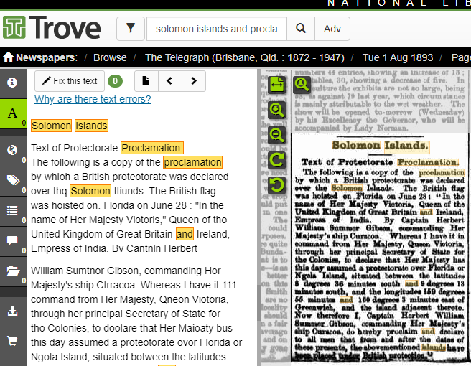
National Library of Australia:
TROVE
http://trove.nla.gov.au/newspaper
Notes:
I also found the Trove New Archive at the National Library of Australia to be very helpful to pinpoint dates since the gazettes are not organized by subject. Also the Australian newspapers reported first hand accounts of activities in the Pacific and reprinted some of the primary documentation along with a more readable format next to the original documents.

Slide 26
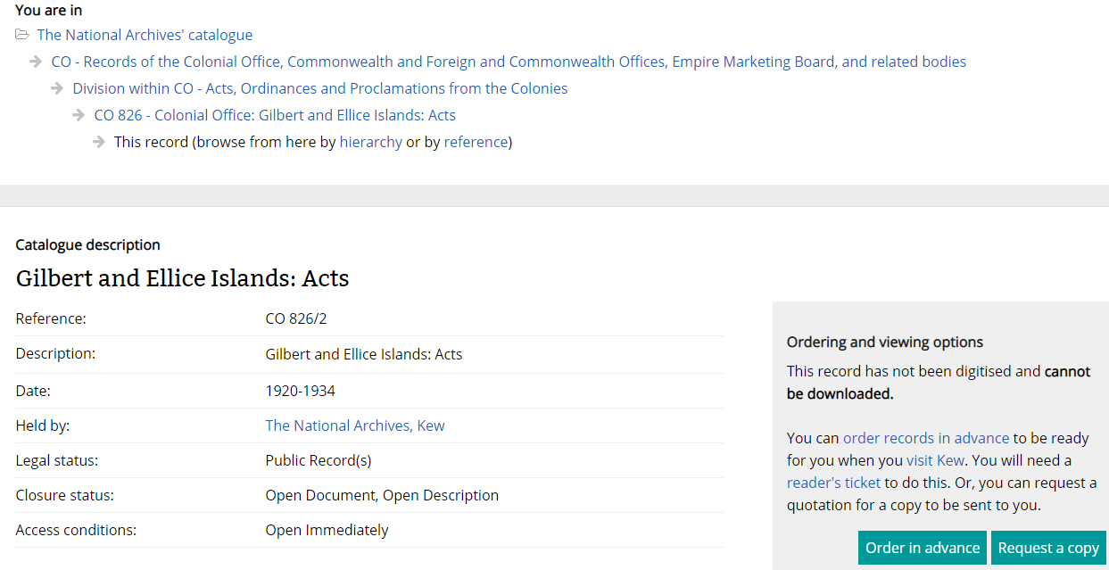
The (British) National Archvies
CO 826
https://discovery.nationalarchives.gov.uk
Notes:
Finally a hat tip to the British National Archives who were very helpful in digitizing some documents and sending them to me for a very small fee. The British National Archive holds many documents related to these jurisdictions, but it is a mistake to believe that all existing records are housed there. Great Britain preferred that its dependencies fund and manage their own affairs. As a result, many records from this period were created and remain in the Pacific. The local archives for the Gilbert and Ellice Islands and the British Solomon Islands live in their respective jurisdictions. The records for New Hebrides, Tonga and the High Commissioner of the Western Pacific are housed in the Western Pacific Archive at the University of Auckland.
However, the librarians here were most responsive and once you mastered their database, I uncovered a lot of sources much more easily. For example, all document types and countries from the colonial period are assigned an alpha numeric code that can be used as a search term. The CO stands for Colonial Office and 826 is the numerical equivalent to search for the Acts of this jurisdiction. . For those interested in how the British Colonial Office organized its records, Mandy Banton’s 2008 publication, Administering the Empire, 1801 – 1968: A Guide to the Records of the Colonial Office in the National Archives of the U.K. She makes sense out of a convoluted structure and anyone attempting to conduct research at Kew Gardens, London should use her monograph as a manual.

Slide 27

Thank you for listening!
Please refer to your handout for resource information used in this presentation.
Notes:
So that about ends my whirlwind tour of a three year research project. Thank you for listening!

