Slide 1

Is Google Winning?
how academic libraries are changing their value proposition to attract users
November 12, 2009

Slide 2
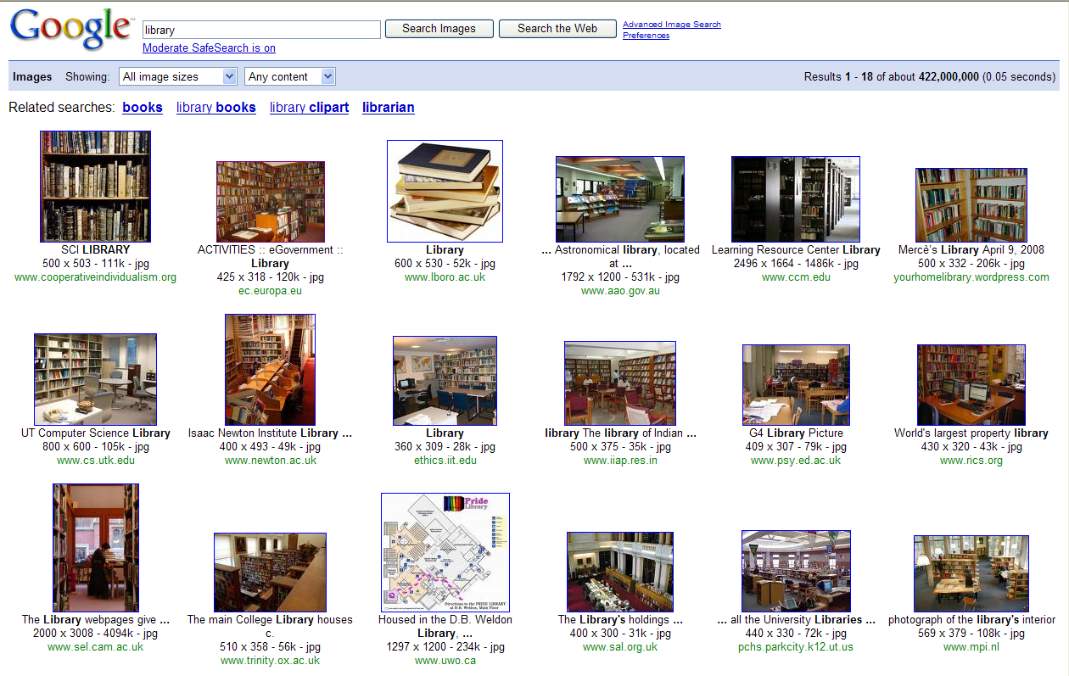
Notes:
A Google image search for library brings up this screen of results, which as we all know represents only one facet of what libraries and their collections look like today.

Slide 3
ARL Libraries and E-Content
In 2006-2007:
  The average ARL university library spent just under 47% of its materials budget on electronic materials
  50 ARL libraries spent more than 50% of their materials budget on electronic materials
http://www.arl.org/stats/annualsurveys/arlstats/arlstats07.shtml
Notes:
The investment in e-content by ARL Libraries exceeded half a billion dollars in 2006-2007. A given library’s content is scattered across dozens of servers and platforms, often leaving users uncertain about where to start or what resource to use.

Slide 4
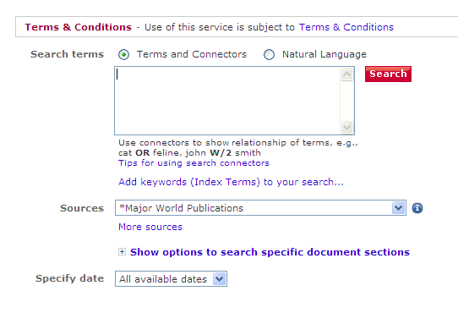
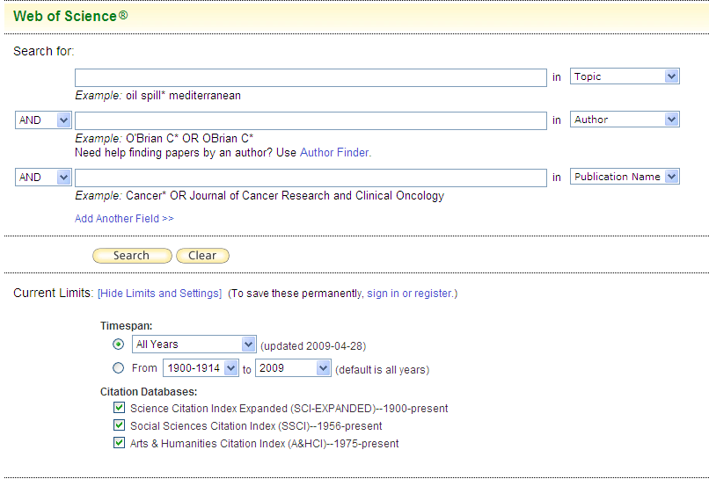
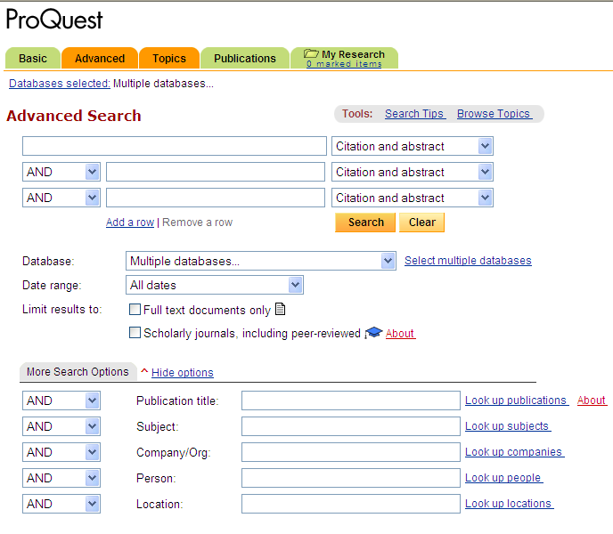
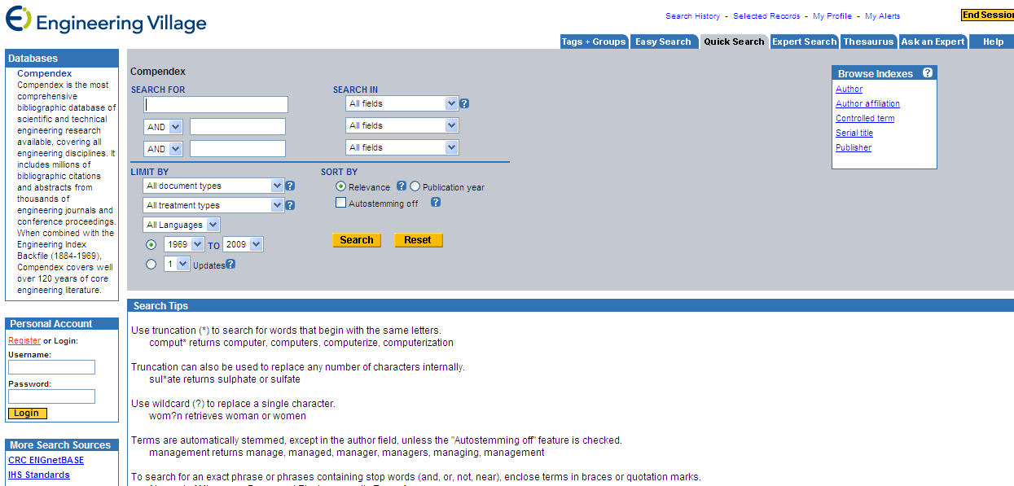
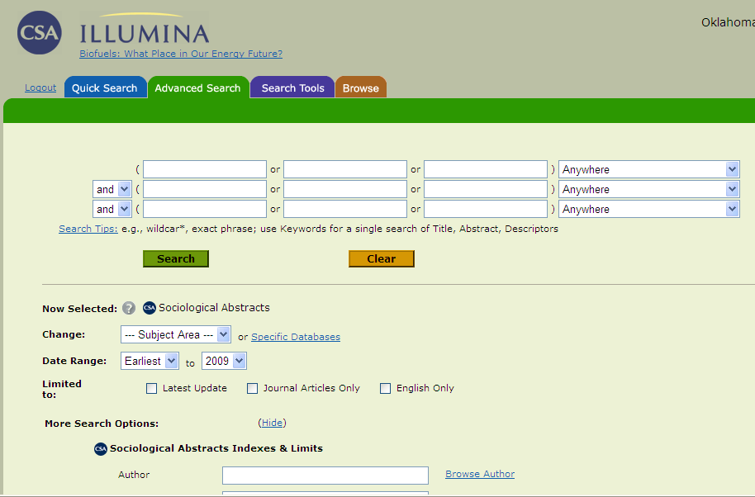
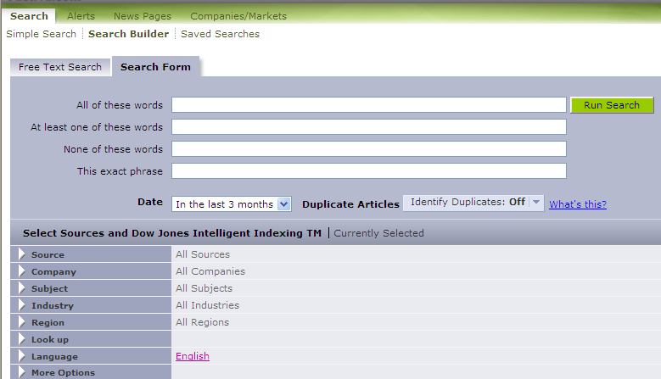
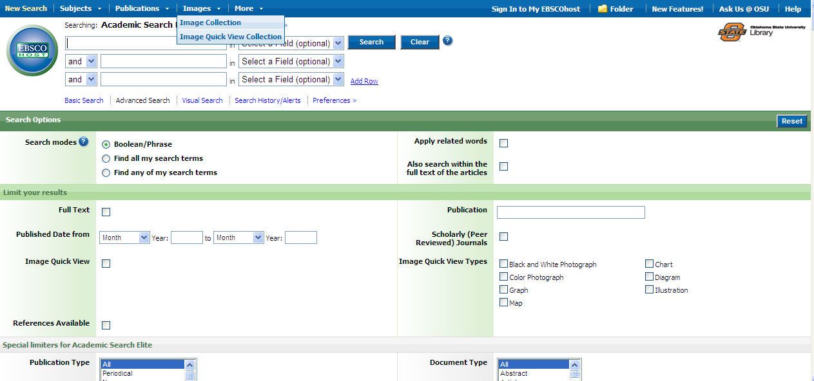

Slide 5
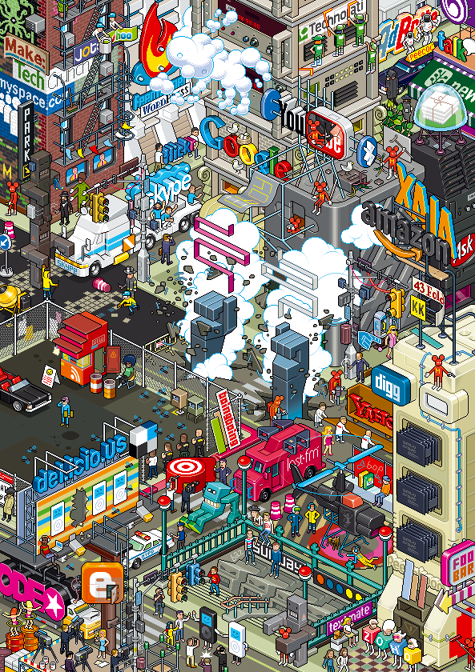
http://hello.eboy.com/eboy/wp-content/uploads/shop/EBY_FooBar_35t.png
Notes:
Our users increasingly expect the complex world of information in which they exist to be easily and intuitively explored. If Google, Amazon, YouTube, and so on can do it, why can’t libraries provide equally accessible tools?

Slide 6
Before we wring our hands and throw in the towel . . . ..

Slide 7
What have we done to improve access?
E-journal portals
OpenURL linking via Link Resolvers
Deep linking to OPACs and Link Resolvers from Google, and Open WorldCat
Linking from OPACs to full/partial GoogleBook content
Federated Search
  Adding search box to Library homepage
  Adding search box to course management system
Next-gen interfaces to OPACs

Slide 8
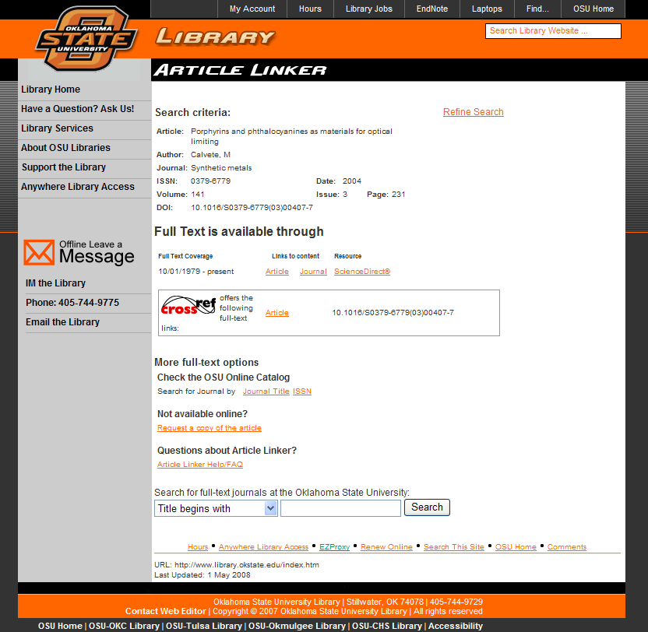
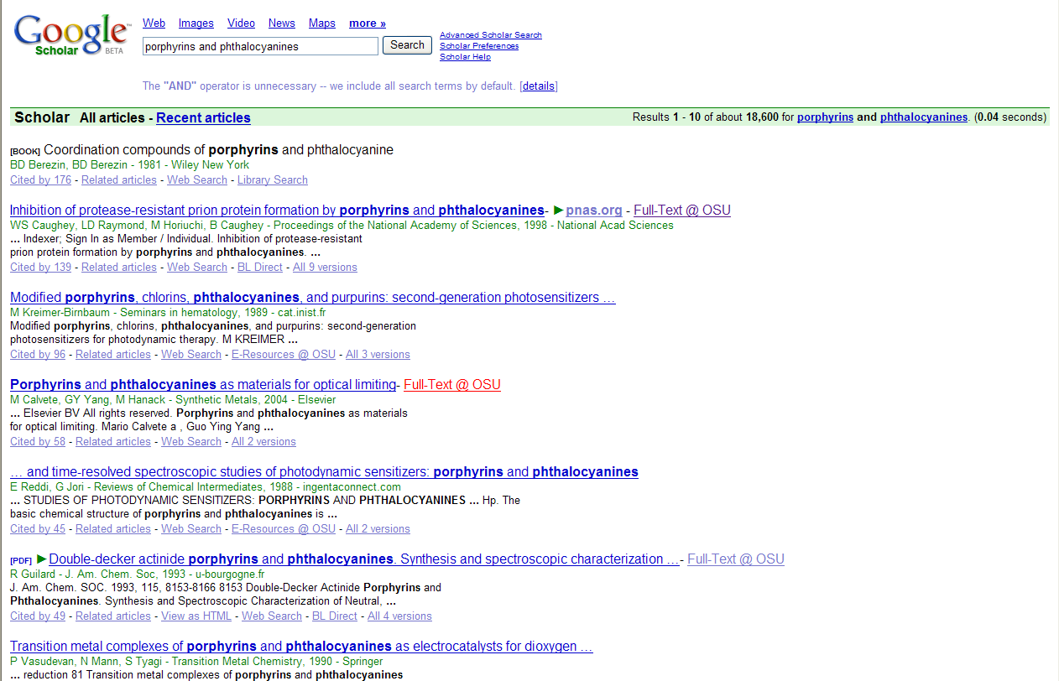
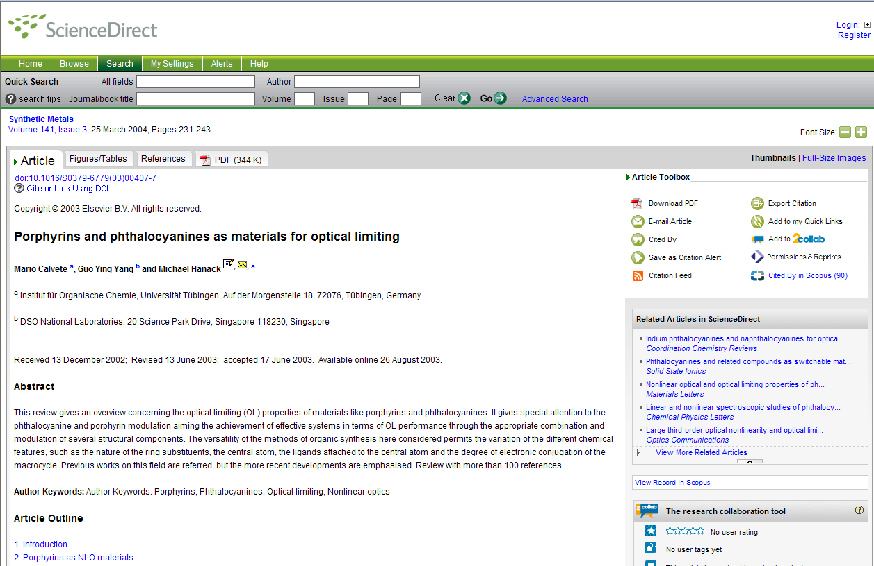
Links to Articles from GoogleScholar
http://scholar.google.com/intl/en/scholar/libraries.html

Slide 9
What do we know about use of our e-content?
Article downloads are up (change from previous year)
  2006 ↑9.08% 2007 ↑18.67% 2008 ↑ 13.29%
Searches in A&I/FT databases are up overall, BUT
  Searches in many discipline specific resources are down
    some for which fed search is not available are down significantly
  Very few searches are done via e-content provider portals

Slide 10
What do we know about use of our e-content?
LinkResolvers drive a significant % of connections to FT (change from previous year)
2007 ↑3.09% 2008 ↑7.68% 2009 ↑ ~20% (12 mo est)

Slide 11
What do we know about use of our e-content?
Federated search has increased traffic to many A&I databases

Slide 12
Federated Search Increases
(change from previous year)
 | 2007 | 2008
Essay & General Literature Index | 27.64% | 26.48%
General Science Abstracts | 21.87% | 27.45%
Hospitality & Tourism Index | 86.36% | 405.16%
Inspec | 29.16% | 25.76%
PsycARTICLES | 28.31% | 19.56%
RILM Abstracts of Music Literature | 58.41% | 33.19%
SPORTDiscus | 24.38% | 29.20%

Slide 13
What’s the bottom line?
Change in Cost per Article Downloaded
2005-2008
Package A | -28.39%
Package B | -26.83%
Package C | -14.49%
Package D | -47.09%

Slide 14
What’s the bottom line?
Change in Cost per Search
2005-2008
Essay & General Literature Index | -91.89%
General Science Abstracts | -84.40%
Hospitality & Tourism Index | -86.73%
Inspec | -92.70%
PsycARTICLES | -70.94%
RILM Abstracts of Music Literature | -94.35%
SPORTDiscus | -95.77%

Slide 15
Issues with fed search
Connectivity issues, timeouts, erratic results
Distortion of usage statistics from some providers
Problems aggregating/displaying results with varying formats and field structures
OpenURL links sometimes fail because of this

Slide 16
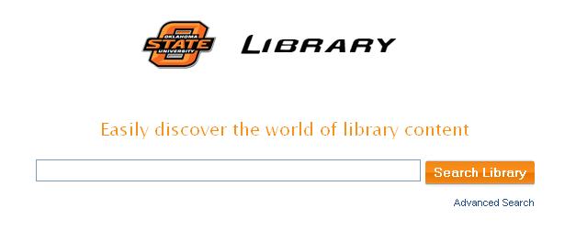
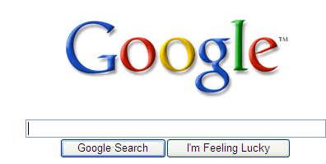

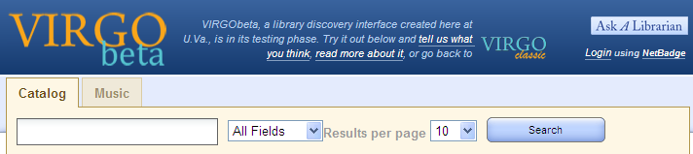
Notes:
Over the past couple of years the single search box concept so familiar from Google has migrated to library search interfaces.

Slide 17
What about that single search box?
We’re dumbing down our catalogs
We’re dumping all the $$$ and work we’ve done in creating rich MARC records
Subject searching is IMPORTANT
We just need to teach them to use the specialized tools we’ve built

Slide 18
Scholarly, Popular, and Blog Views?
“ ’Googlization is bastardization’ of the research and reference process. ”
  2006. Norris, Benjamin P. “Google: Its Impact on the Library”. Library Hi Tech News 23 (9) 9 – 11.
“Is Google Making Us Stupid?”
  http://www.theatlantic.com/doc/200807/google
“Web 2.0: Opening up, or dumbing down? Are Google, Wikipedia, YouTube, and other Web 2.0 giants the scourge of American culture, laying waste to its 20th-century institutions and dumbing down society? “
  http://www.physorg.com/news126453534.html

Slide 19
How much do you know about your OPAC?
One year of search log analysis for traditional OPAC vs. “next-gen” catalog
Exclude all searches from staff clients
It’s messy work, but can be incredibly informative – and downright frightening!

Slide 20
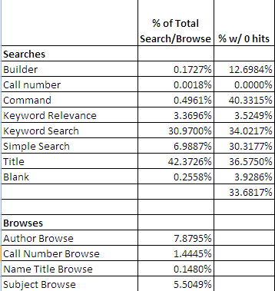
Traditional OPAC

Slide 21
How does it compare to Next-Gen?
Measure | Traditional | Next-Gen
% of searches w/ no hits | >33% | <10%
% of searches - subject | 5.5% | n/a
% of searches that used limits/refine elements | 8.6% | **22.5%
**Topic and format are two most commonly used refine elements

Slide 22
Why does Next-Gen often yield more hits?
Every word in bib record is indexed and searchable
Searchable summaries and TOCs from Syndetics
Searches phrase, then ANDs search terms

Slide 23
Why No Hits
Sometimes “0” is the right answer
Don’t know the rules
Typos and misspellings
Typing in the wrong box

Slide 24
Sometimes “0” is the right answer
Where is the mango princess
I hope they serve beer in hell
May contain nuts a novel of extreme (parenting)
scarith of scornello
chuck's truck

Slide 25
Don’t know the rules
Title Search - The kite runner (Traditional – 0; Next-Gen – 10)
La maison du chocolat : transcendent desserts by the legendary chocolatier (Traditional – 0; Next-Gen – 1)
Builder Search – romeo OR and OR juliet (Traditional – 0; Next-Gen – 255)
Title or Keyword Search - college students working while going to school (Traditional – 0; Next-Gen – 13)

Slide 26
Typos and misspellings
Punlic tobacco use (Traditional – 0; Next-Gen gives “Did you mean” – 201)
understanding plauys - (Traditional – 0; Next-Gen gives “Did you mean” – 2,604)
organosilicon chemsitry bok – (Traditional – 0; Next-Gen – 0) we can fix this in Next-Gen
stretchy lesson plan – we could fix this one if we knew what was meant!

Slide 27
Copyright guide for librarians and educators
Traditional Results
  Title Search: - 0
  Keyword – 0 - Any of these; All of these; As a phrase
Next-Gen Results – 40
  Copyright law for librarians and educators : creative strategies and practical solutions / Kenneth D. Crews ; with contributions from Dwayne K. Buttler ... [et al.].
  Copyright for schools : a practical guide / Carol Simpson.
  Library instruction for librarians / Anne F. Roberts and Susan G. Blandy ; foreword by Richard Halsey.
  Applying the new copyright law : a guide for educators and librarians / Jerome K. Miller.
  Complete copyright : an everyday guide for librarians / Carrie Russell ; with contributions from Dwayne K. Buttler ... [et al.].
  Does your project have a copyright problem? : a decision making guide for librarians / by Mary Brandt Jensen.

Slide 28
Cautionary Words
“Only librarians like to search; everyone else likes to find”
“We digital library developers don't get up in the morning wondering how we can ruin the lives of our patrons. Nonetheless, unintended consequences of our work may damage the capacity of libraries to serve their clienteles”
Roy Tennant - http://www.libraryjournal.com/article/CA156524.html

Slide 29
Cautionary Words
“Information literacy is also harmful because it encourages librarians to teach ways to deal with the complexity of information retrieval, rather than to try to reduce that complexity. “
“Indeed, if she were to use her library's Web site, with its dozens of user interfaces, search protocols, and limitations, she might with some justification conclude that it is the library, not her, that needs help understanding the nature of electronic information retrieval.”
Stanley Wilder - http://chronicle.com/weekly/v51/i18/18b01301.htm

Slide 30
The User Is Not Broken: A meme masquerading as a manifesto
  You fear loss of control, but that has already happened. Ride the wave.
  The user is not broken.
  Your system is broken until proven otherwise.
  Information flows down the path of least resistance. If you block a tool the users want, users will go elsewhere to find it.
  Karen Schneider - http://freerangelibrarian.com/2006/06/03/the-user-is-not-broken-a-meme-masquerading-as-a-manifesto/

Slide 31
We’ve made a lot of progress, but we’ve got a ways to go . . . . .

Slide 32
What do we want?
Simple, yet powerful interface
  “Simplicity is complexity done well.” (Jeff Jarvis - What Would Google Do)
Faster query time
Consistent results
Improved relevancy ranking
Powerful refine tools
Improved linking
Format agnostic

Slide 33

What’s next at OSU?
Bigger, better

Slide 34
Questions????
Dr. Anne Prestamo
Associate Dean for Collection and Technology Services
Oklahoma State University Libraries
anne.prestamo@okstate.edu

