Slide 1
ʻÖlelo Hawaiʻi and uchinaaguchi: Language Preservation and Cultural Revitalization in Hawaiʻi and Okinawa
Jodie Mattos, University of Hawai‘i at Mänoa
Hawaiian Collection

Slide 2
Overview of Hawai‘i and Okinawa
Similarities
Former kingdoms
  1879, Japan annexes Okinawa, becomes a prefecture
  1893, U.S. overthrows Hawaiian monarchy
Tourism
  Tourists to Okinawa, 9,396,200 in 2017, up 9.1% from 2016
  Tourists to Hawai‘i, 9,404,346 visitors in 2017, up 5.9% from 2016

Slide 3
Overview (continued)
Militarism
  Okinawa’s current land area is ~563,647 acres (0.6% of Japan’s total land area) BUT the land exclusively used by the U.S. military is concentrated in Okinawa
  U.S. military controls 5% of land in Hawai‘i, 22.4% of the land on O‘ahu
Colonialism
  Loss of language & culture
    State of Hawai‘i report, 5.7% of population speaks ‘ōlelo Hawai‘i
    Jan. 2017 poll by Ryukyu Shimpo, 41.2% of older Okinawans can speak Okinawan languages but only 7.5% of Okinawans in their 20s could speak it
Notes:
https://www.japantimes.co.jp/news/2018/02/09/national/okinawa-tourist-numbers-top-hawaii-first-time/Tourists
What Okinawa Wants You to Understand about the U.S. Military Bases, http://dc-office.org/wp-content/uploads/2018/03/E-all.pdf
https://www.culturalsurvival.org/publications/cultural-survival-quarterly/nation-under-gun-militarism-and-resistance-Hawaii (21 installations, 26 housing complexes, 8 training areas, and 19 miscellaneous bases and operating stations)

Slide 4
2019--UNESCO International Year of Indigenous Languages
Language represents a person’s unique cultural identity, history, traditions, and memory
Language loss = cultural loss
Notes:
UNESCO considers Uchinaaguchi as endangered and Hawaiian as critically endangered

Slide 5
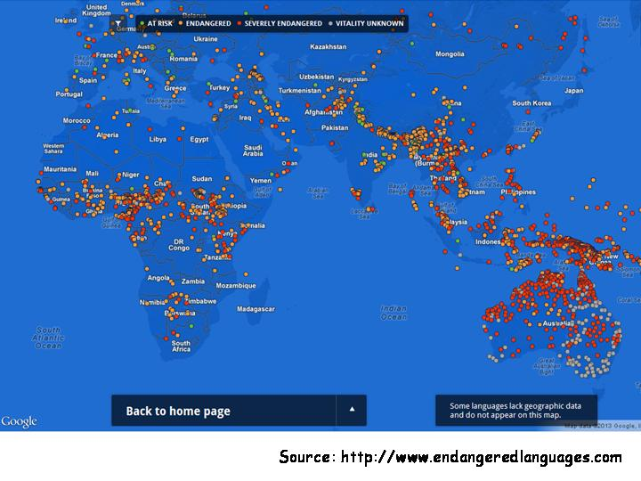
Notes:
https://www.languagesoftheworld.info/geolinguistics/endangered-languages/striking-new-map-endangered-languages.html

Slide 6
Language Loss
Currently, about 6.000-7.000 languages in the world.
About 97% of the world’s population speaks only 4% of these languages, while only 3% of the world speaks 96% of all remaining languages.
A great majority of those languages, spoken mainly by indigenous peoples, will continue to disappear at an alarming rate.
Notes:
(per https://en.unesco.org/news/unesco-launches-website-international-year-indigenous-languages-iyil2019)

Slide 7
Hawaiian Language Loss
1896 law prohibiting teaching of Hawaiian in public & private schools
“Language is the first aspect of a people to vanish” Larry Kimura, UH Hilo
  “It takes three generations of native speakers to reestablish a language; [Hawai‘i] is now seeing its third generation of new Hawaiian native speakers—defined as children who are raised with Hawaiian at home until they are 3 or 4”
Language loss coupled with cultural loss
Notes:
See shift from Hawaiian and English used in the kingdom to English as the official language; Hawaiian punished for speaking their language so children are not taught ‘ōlelo Hawai‘i.
https://books.google.com/books?id=VSxHAQAAIAAJ&pg=RA1-PA23#v=onepage&q&f=false
1st Kimura quote: NPR, June 22, 2019, https://www.npr.org/sections/codeswitch/2019/06/22/452551172/the-hawaiian-language-nearly-died-a-radio-show-sparked-its-revival
2nd Kimura quote: NBC news, March 17, 2017, https://www.nbcnews.com/news/asian-america/hawaiian-language-revival-used-model-other-indigenous-languages-n734891
Disconnected to culture & language and Native Hawaiian identity

Slide 8
Hawaiian Language Revitalization
‘Aha Pūnana Leo, immersion school, begun in 1982
  Closely tied to educational model from Māori, Aotearoa
  Started first preschool in Kekaha, Kaua‘i
Created their own resources in ‘ōlelo Hawai‘i
‘Ōlelo Hawai‘i & English, official languages
Ka Papahana Kaiapuni, Dept. of Education public Hawaiian language immersion schools
Seeing increase in speakers, from preschool to graduate school (dissertations written in ‘ōlelo Hawai‘i at UHM & UH Hilo)
Notes:
Hawaiian language speaking children under the age of 18 numbered less than 50, community of fluent speakers had dwindled to a few elders & geographically isolated population of Ni‘ihau. ‘Aha Pūnana Leo means “nest of voices”, per their website, http://www.ahapunanaleo.org/index.php?/about/aha_puunana_leo_in_the_spotlight/
Had to create their own resources since none existed; parents committed to learning ‘ōlelo Hawai‘i so language could be spoken in the family, not just at school
1978, 2 official languages of the State of Hawai‘i
Currently, 18 traditional public schools & 6 charter schools

Slide 9
Okinawan Language Efforts
Six Okinawan languages
  Uchinaaguchi, the most known Okinawan language
  Decline of Okinawan languages & spread of Japanese language from 1880s
  95,000 native speakers
  Considered “severely endanagered”
Okinawans visiting ‘Aha Pūnana Leo schools
  Using immersion school model
  Native Hawaiians visiting Okinawa
Notes:
http://wubhawaii.com/?p=411
http://www.endangeredlanguages.com/lang/5354
To lend support and offer guidance, how Hawai‘i immersion school example can help Okinawa; also supporting protests against relocation of Marine Corps Air Station Futenma & the impending destruction of Oura Bay and its ecosystem for the move of the inland military base to the coastal area of Henoko.
Amami, Uchinaaguchi, Miyako, Yaeyama, Yonaguni

Slide 10
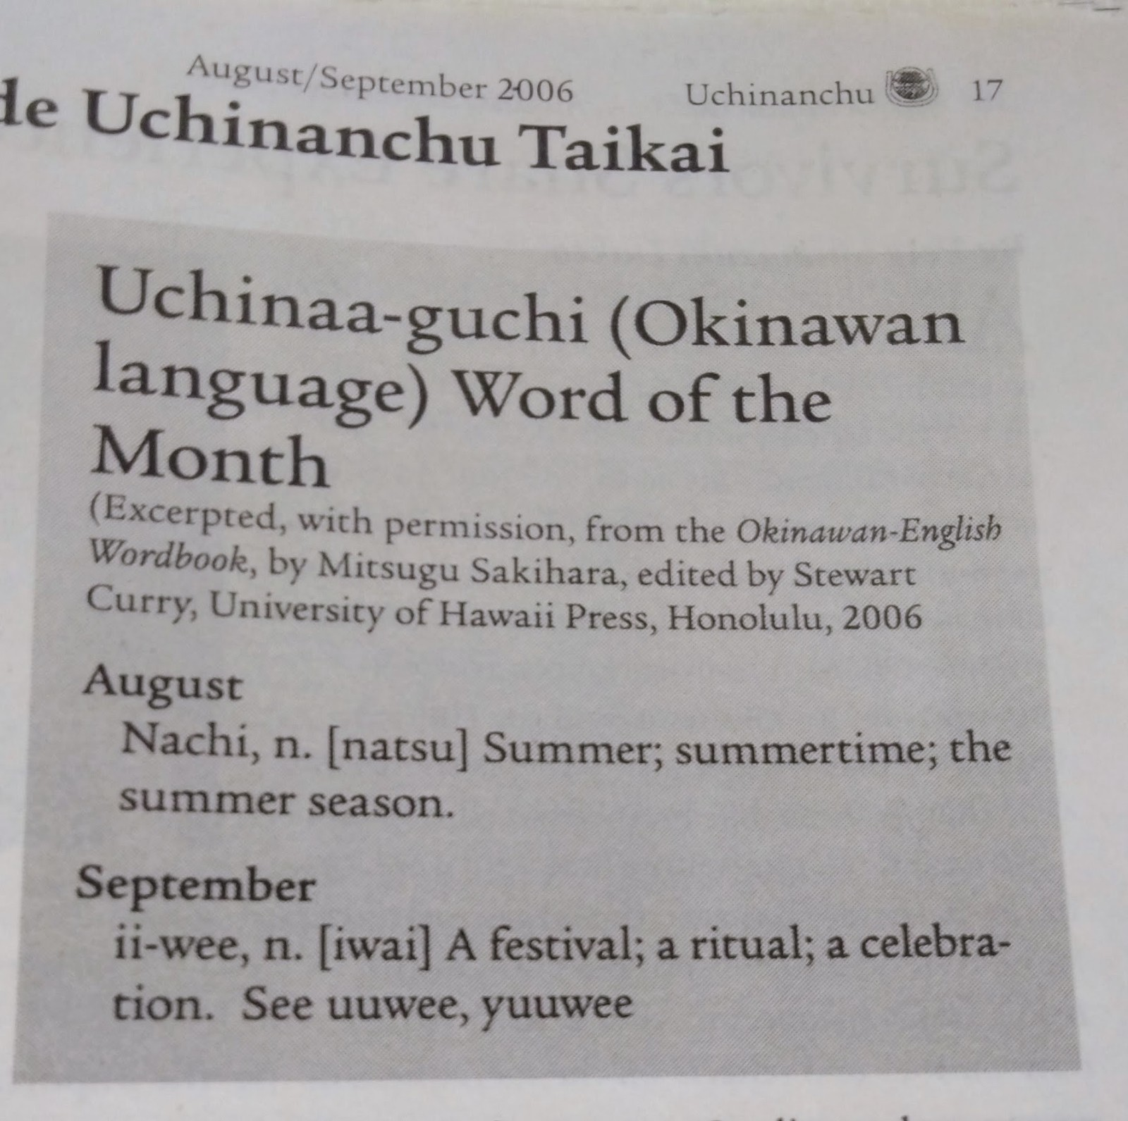
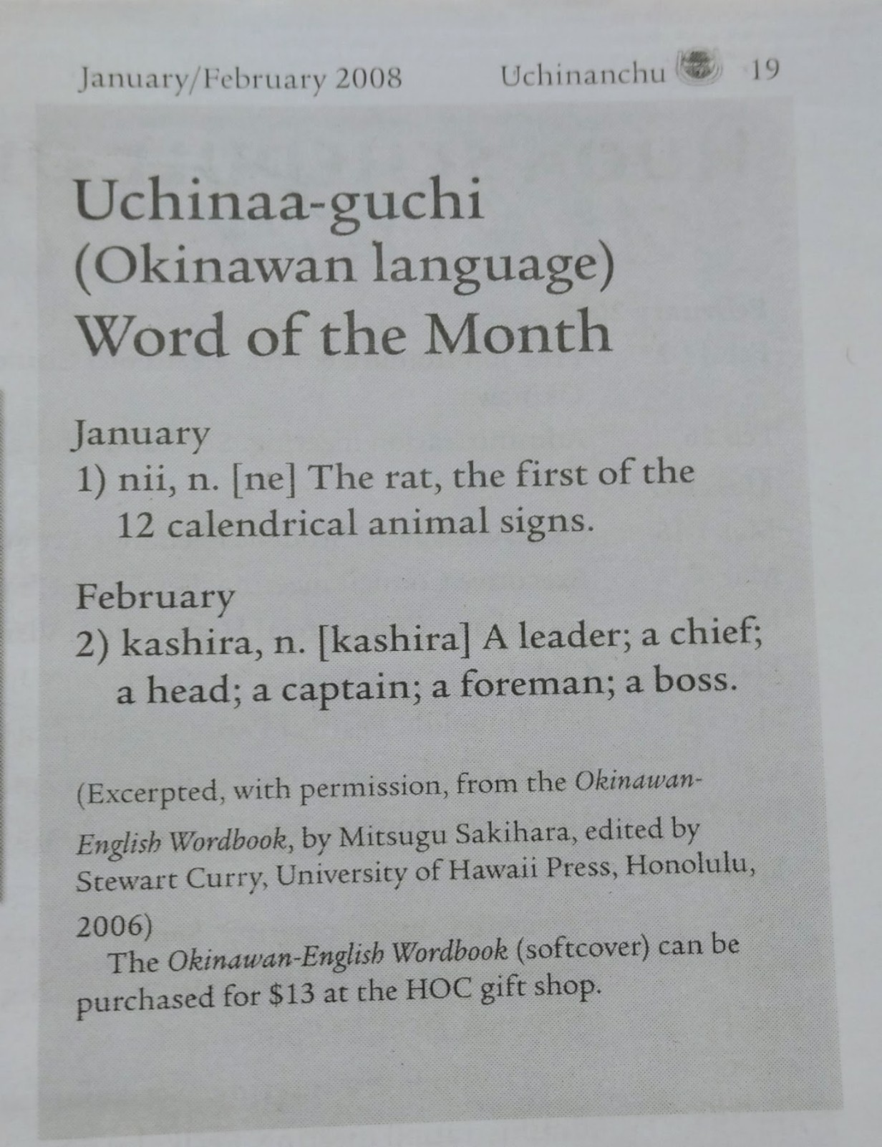
Uchinaaguchi efforts in Hawai‘i
Okinawa Studies Librarian, UHM Library, Sachiko Iwabuchi
Uchinaaguchi word in Uchinanchu newspaper (monthly)
  Began in August/September 2006 issue
Notes:
Collecting Okinawan materials in many languages (Japanese, English, Portuguese)

Slide 11
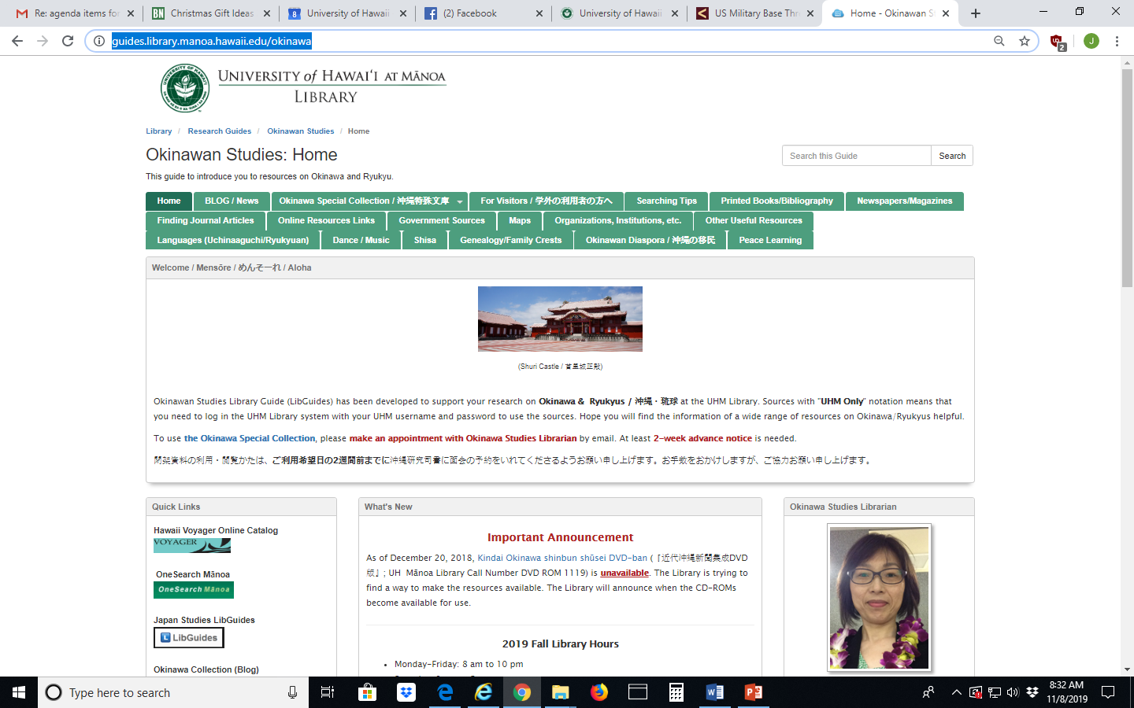
Notes:
https://guides.library.manoa.hawaii.edu/okinawa

Slide 12
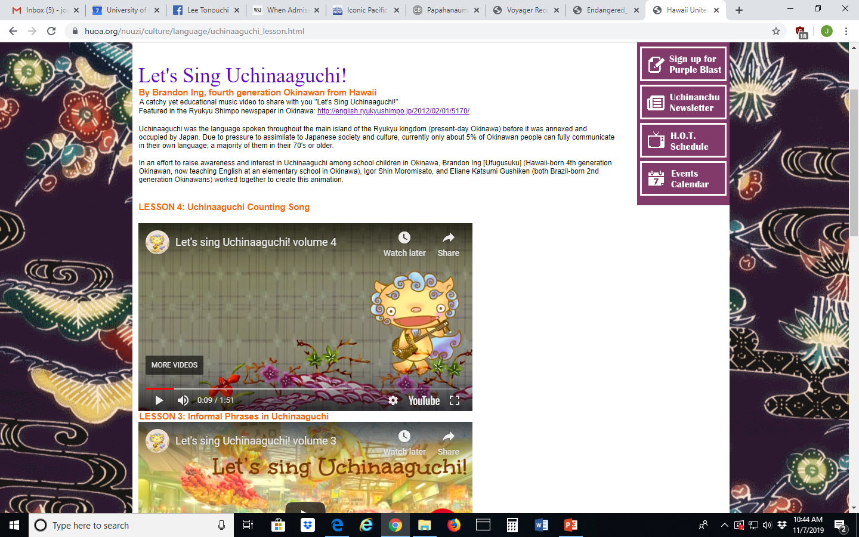
Uchinaaguchi efforts in Hawaii (cont.)
Let’s Speak Uchinaaguchi! (videos)
Language classes offered at Hawaii United Okinawa Association (HUOA) Center
Notes:
https://huoa.org/nuuzi/culture/language/uchinaaguchi_lesson.html
https://huoa.org/nuuzi/calendar/sub/class.html

Slide 13
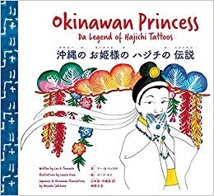
Uchinaaguchi efforts in Hawaii (cont.)
Okinawan Princess: Da Legend of Hajichi Tattoos (Bess Press, 2019)
  Trilingual book written in pidgin English, then translated into Japanese and Uchinaaguchi
  Written by Lee Tonouchi, illustrations by Laura Kina, Japanese & Okinawan translations by Masashi Sakihara
  Held in UHM Library in Hamilton Juvenile, Hamilton Asia & Hamilton Hawaiian

Slide 14
How Do Libraries Fit Into Language Revitalization
Hawaiian Collection, UHM Library holds many Hawaiian language materials
  Collecting priority: materials in ‘ōlelo Hawai‘i and by & about Native Hawaiians
  Hawai‘i education reports (kingdom to state)
  Earliest materials created by ‘Aha Punana Leo to dissertations written in ‘ōlelo Hawai‘i

Slide 15
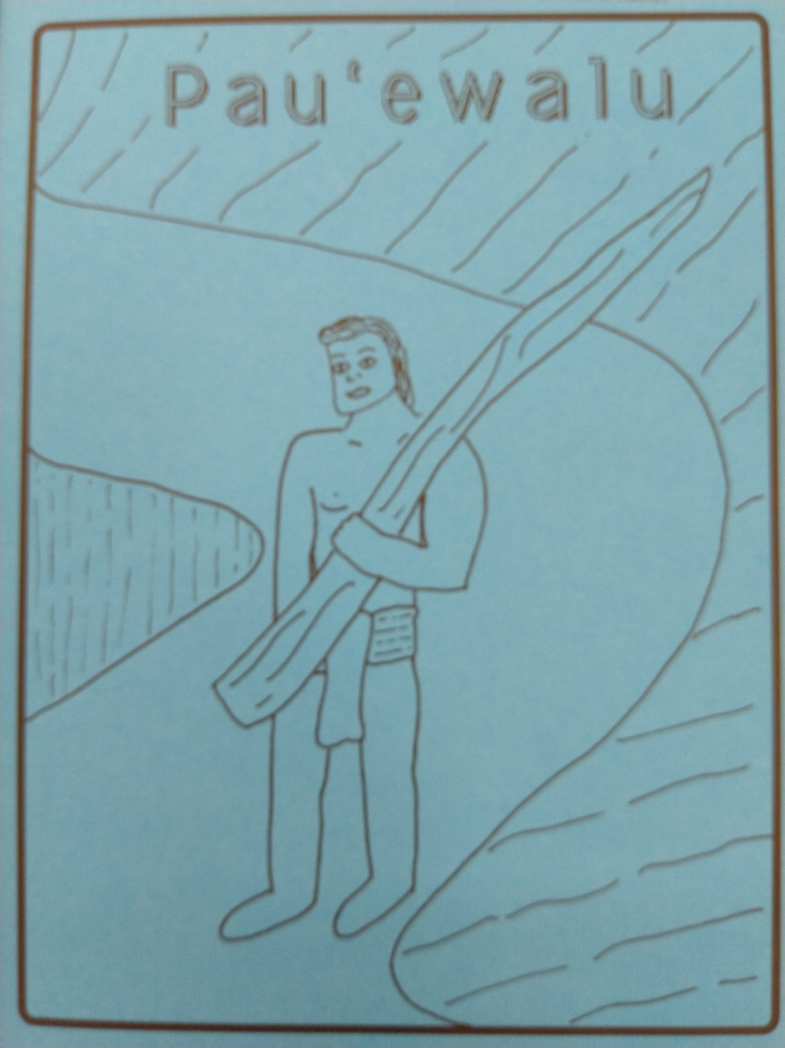
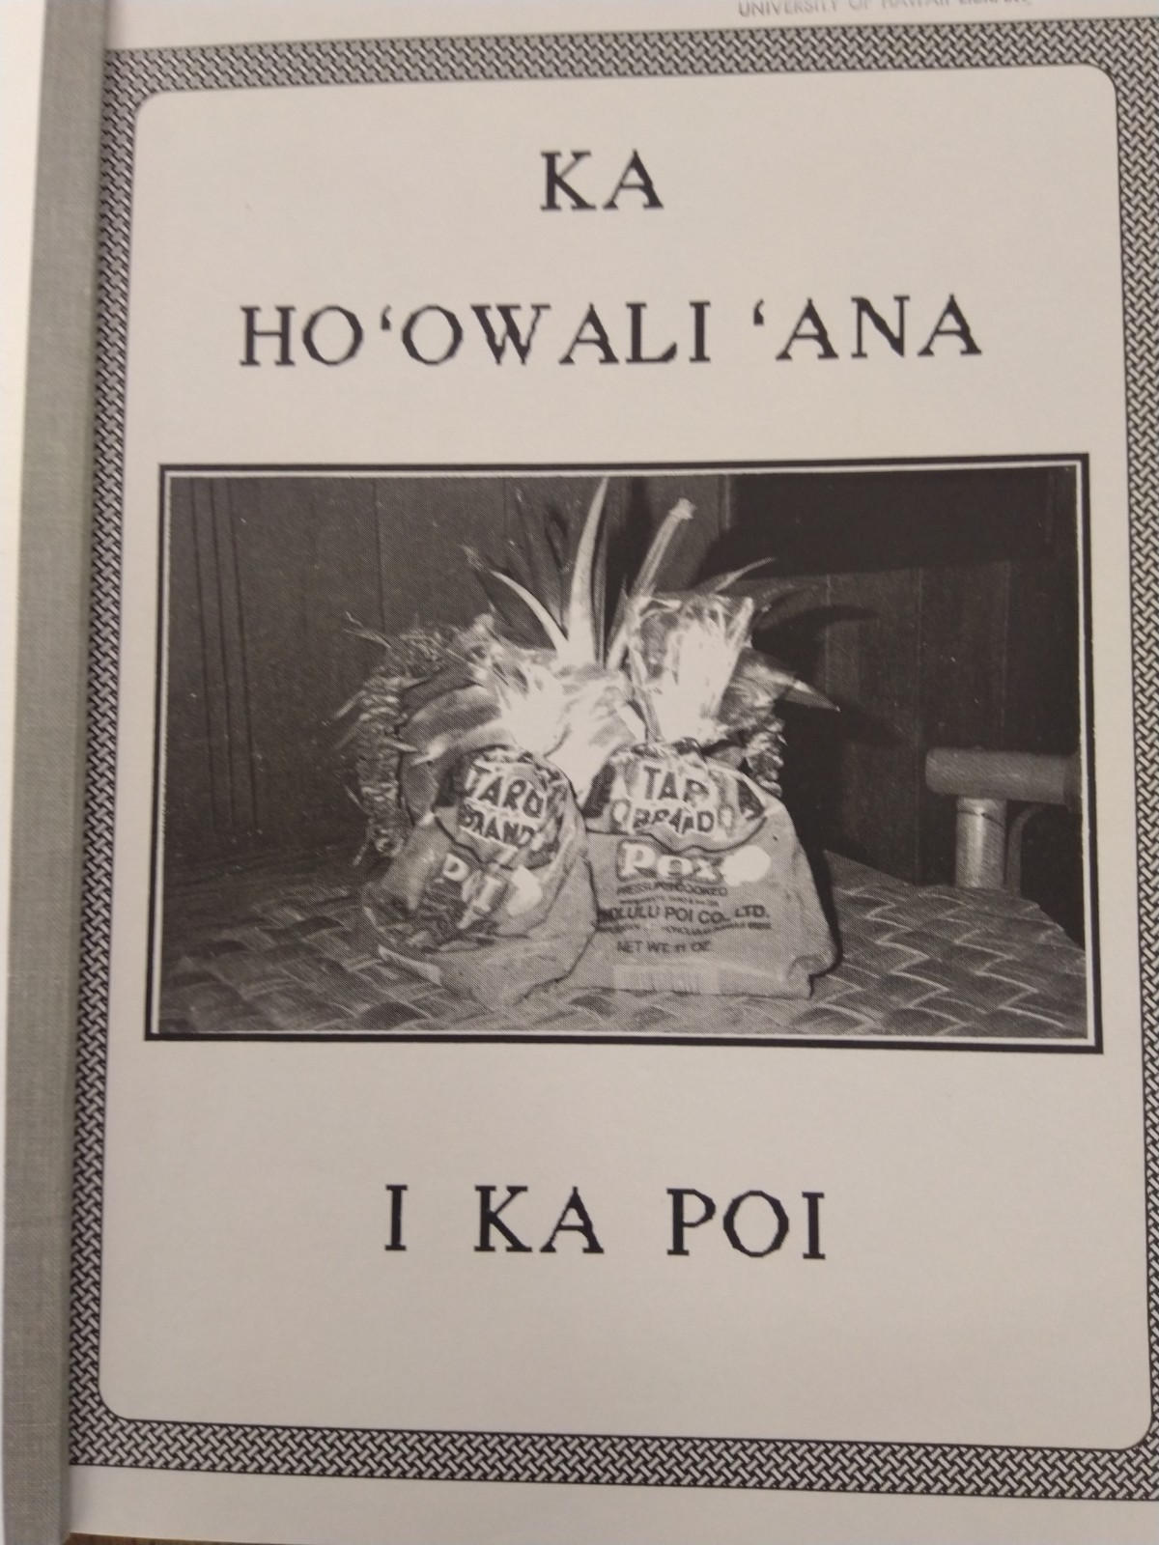
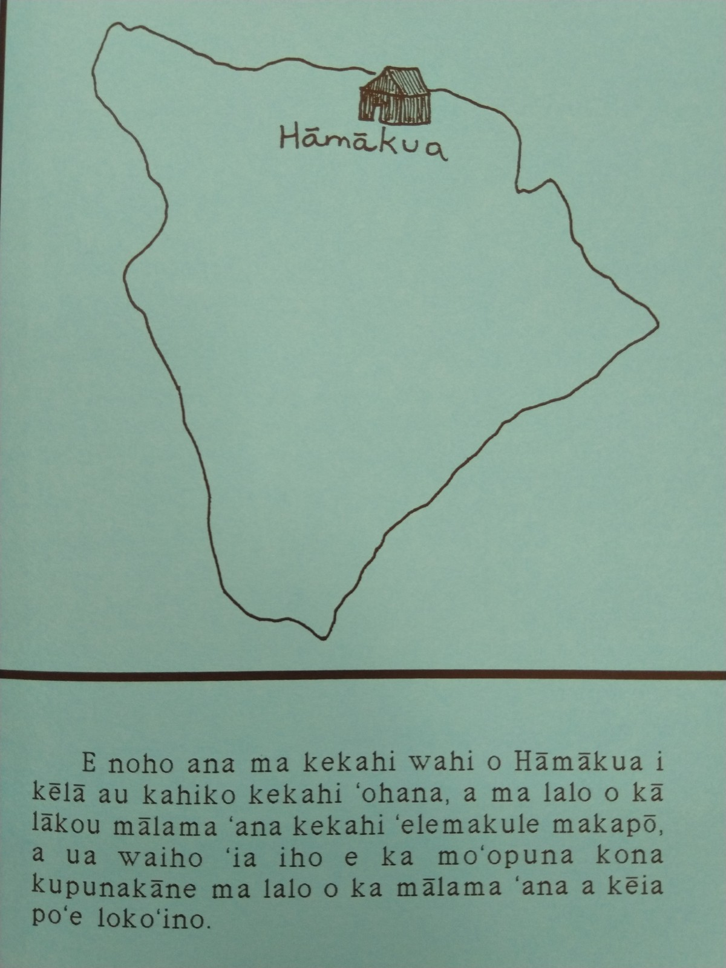
Libraries (cont.)
Hawaiian Collection, University of Hawai‘i at Mānoa (UHM) Library
  Holds readers in ‘ōlelo Hawai‘i
Notes:
http://ulukau.org/kaniaina/?a=p&p=publicationhome&sp=A&e=-------en-20--1--txt-txIN%7ctxTI%7ctxTA%7ctxCO%7ctxTY%7ctxLA%7ctxKE%7ctxPR%7ctxSG%7ctxTO%7ctxTG%7ctxSM%7ctxTR%7ctxSP%7ctxCT%7ctxET%7ctxHT-----------------

Slide 16
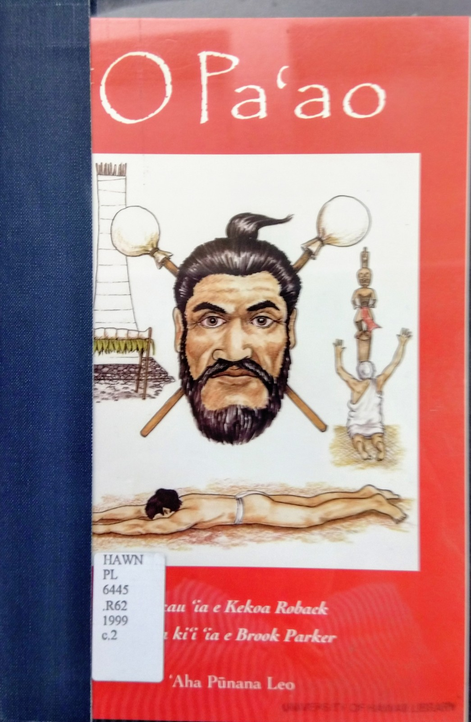
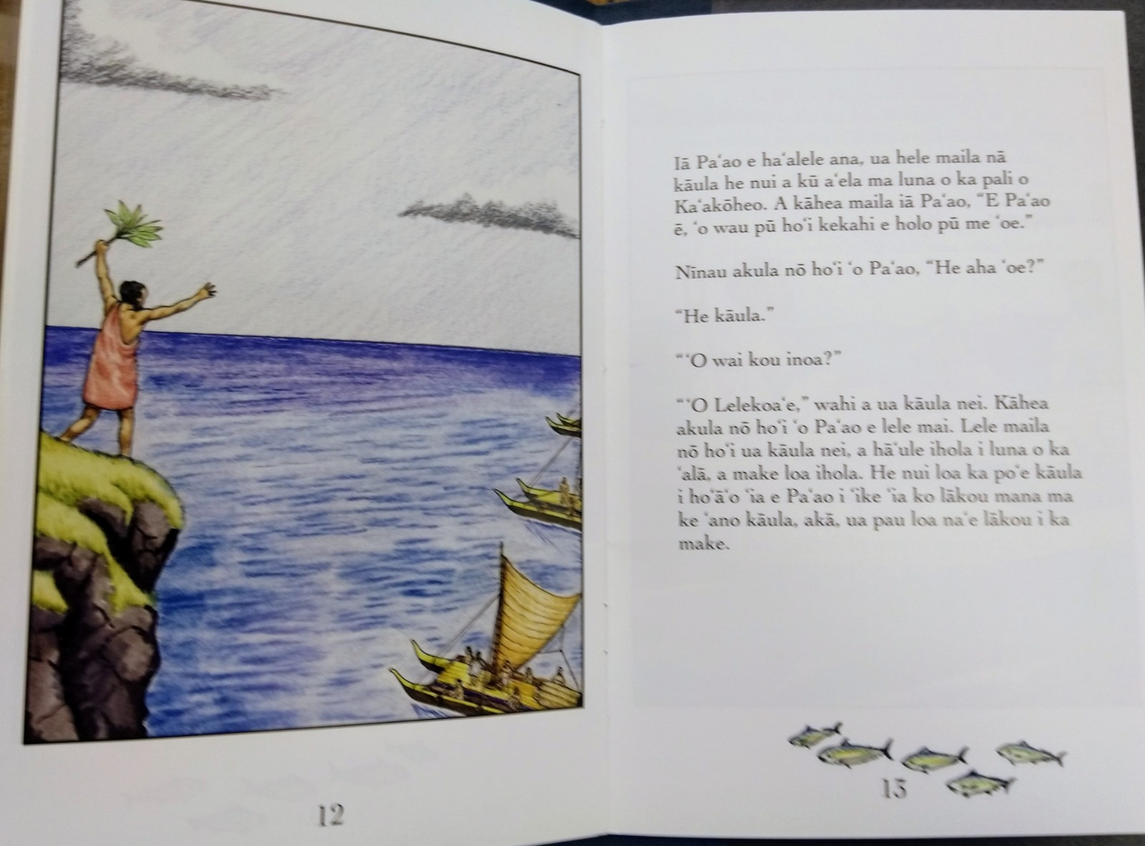
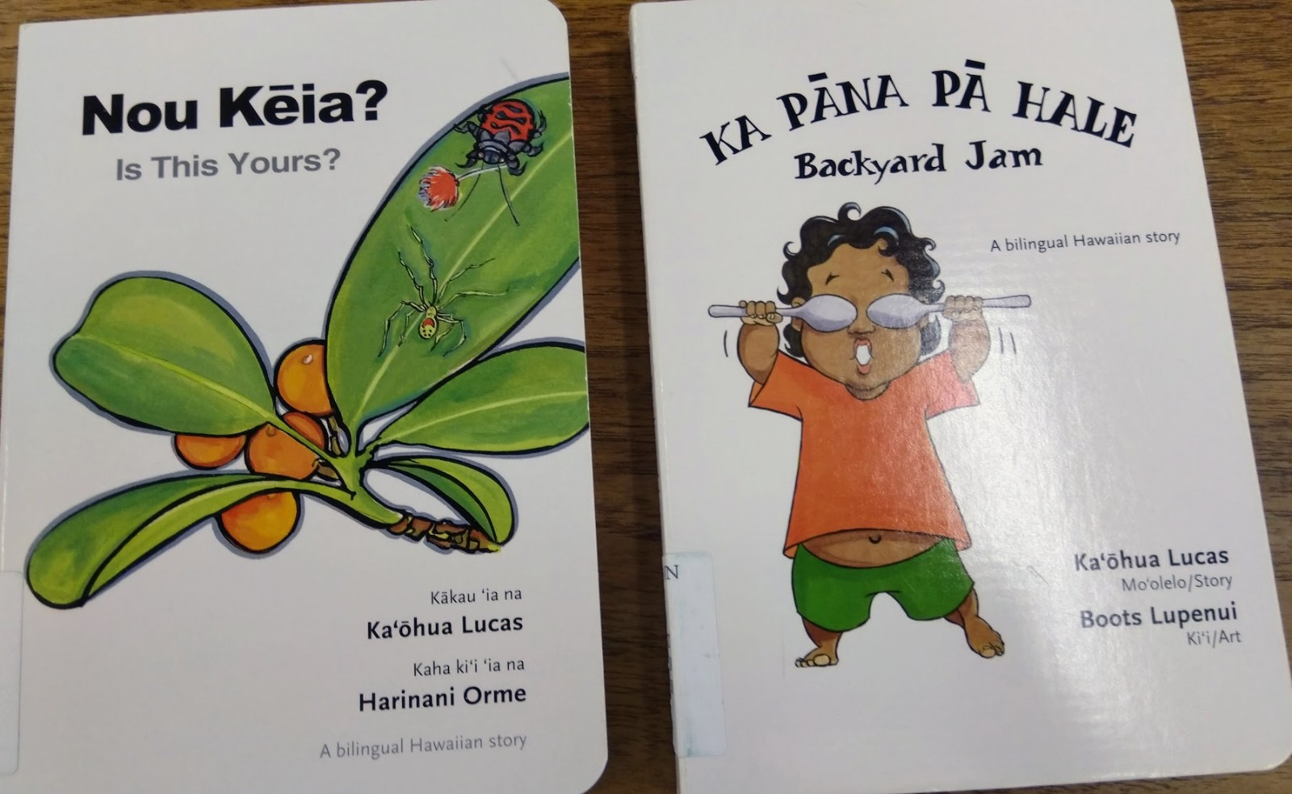
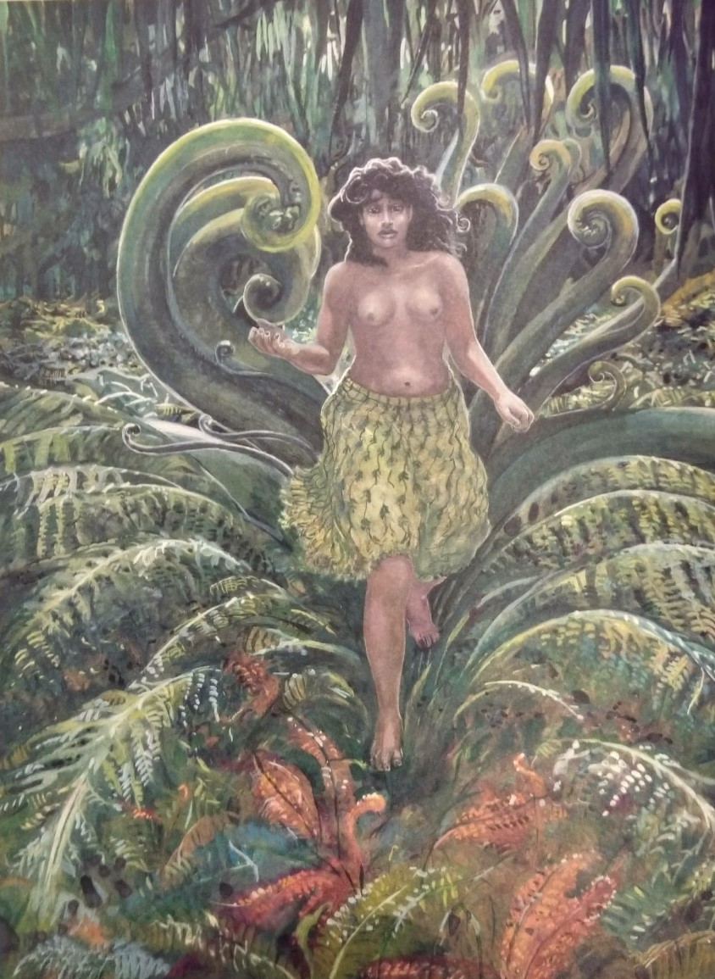
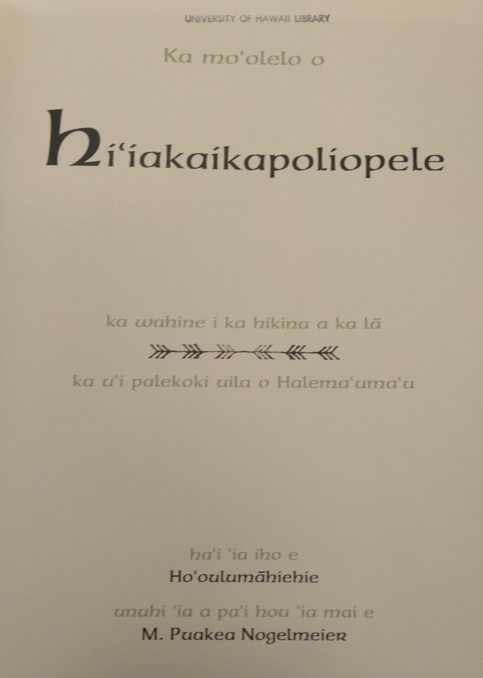
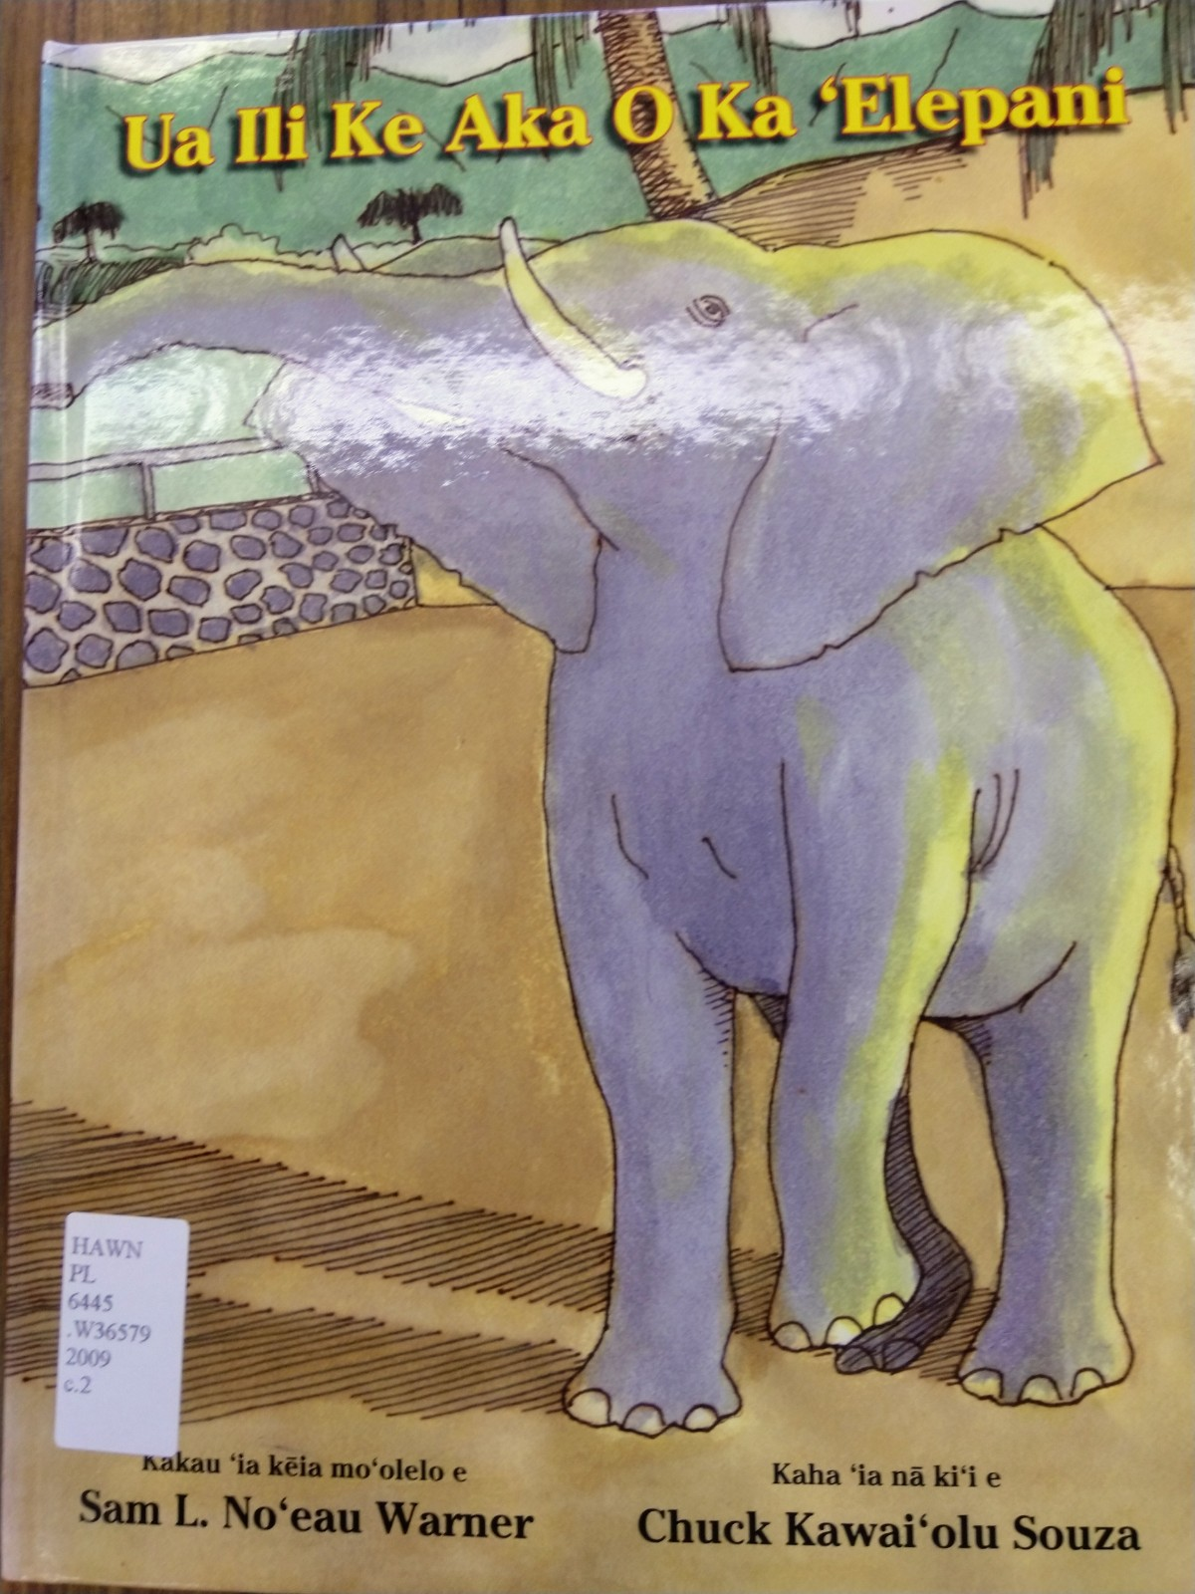
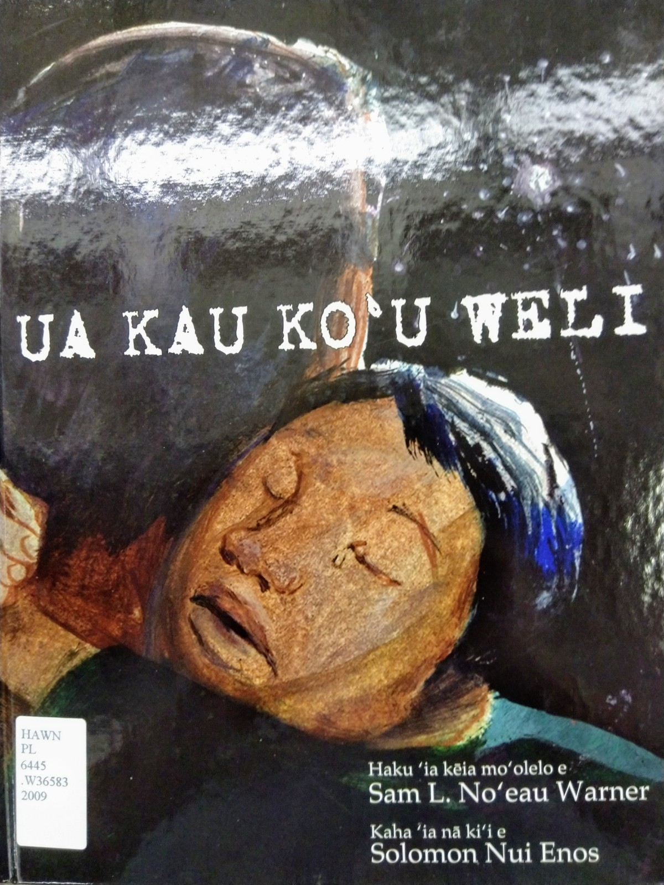
Notes:
The elephant book reminds me of Ka Lama Hawaii newspaper, printed at Lahainaluna with the animal engravings, http://www.hawaiianhistoricalsociety.org/pubs/chapin/3_haw-l.pdf (page 65)

Slide 17


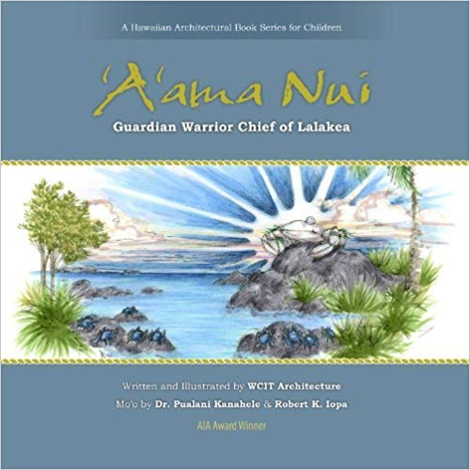


Slide 18
  Ka Leo Hawai‘i radio episodes freely available on Ulukau
    Public Hawaiian language radio program broadcast from 1972 to 1988 with interviews of mainly native Hawaiian speaking kupuna.
    Tapes also held at UHM & UH Hilo Libraries
Notes:
http://ulukau.org/kaniaina/?a=p&p=publicationhome&sp=A&e=-------en-20--1--txt-tpIN%7ctpTI%7ctpTA%7ctpCO%7ctpTY%7ctpLA%7ctpKE%7ctpPR%7ctpSG%7ctpTO%7ctpTG%7ctpSM%7ctpTR%7ctpSP%7ctpCT%7ctpET%7ctpHT%7ctpDT%7ctpOD%7ctpDF-----------------

Slide 19
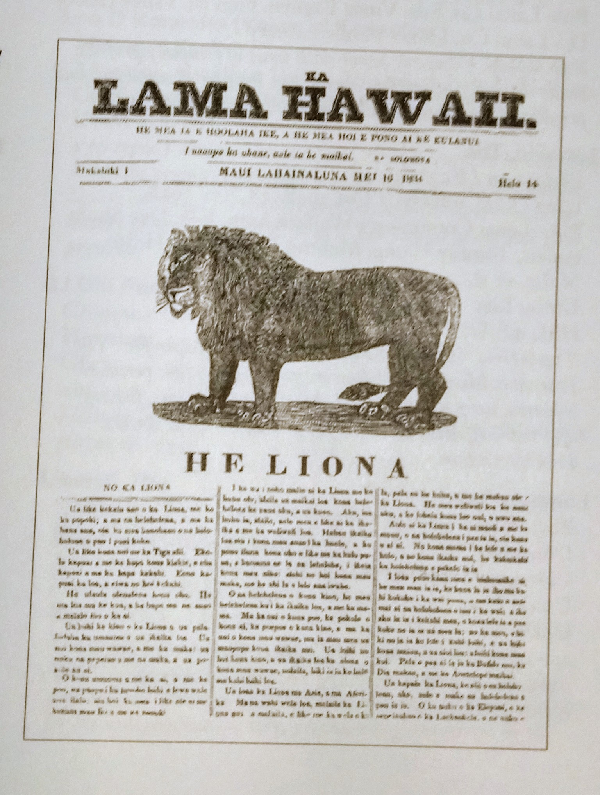

Slide 20
Mahalo and Ippee Nifee Deebiiru!
Email: jodie@hawaii.edu

